Slide 1

Foundations of successful digital libraries, partnerships and sustainability
EcoEd DL Workshop
When a digital library is driven by its users
Gerd Kortemeyer
Michigan State University
LON-CAPA Project

Slide 2
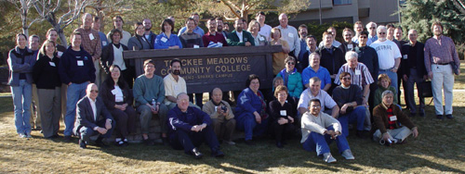
Who is LON-CAPA?
Snap Shot
March 2010
3 faculty leaders
4 fulltime staff
3 parttime staff
2 students doing thesis work
5 publishing companies
1 spin-off business
130 institutions (high schools, colleges, universities)
540 authors

Slide 3
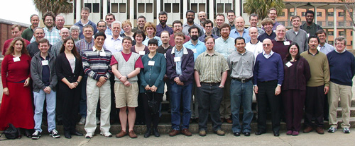
Sustainability
LON-CAPA has been around since 1993, initially as pure homework/assessment system
Since 2000: Digital Library
17 years … with ups and downs
  currently “down” – partner institutions have budget cuts
Components of sustainability:
  financial:
    staff
    hardware
    travel
  ongoing software platform development
  ongoing content contributions
  increasing user community
  scholarship

Slide 4
Sustainability
Lessons learned over 17 years:
Have a clearly defined purpose – even if it precludes some funding “opportunities.” Don’t let money drive you!
Be selective about whom you allow to contribute – but then give them freedom
Distribute – a single institution is too fickle an environment
Share the wealth – help your partner institutions get funding, publicity, etc.

Slide 5
Clearly Defined Purpose
For LON-CAPA:
Allow high school and undergraduate instructors to efficiently select and deploy effective online materials and assessment resources for their students
Corollaries:
  end-users are students – resources are for student “consumption” (not teaching guides, research papers, curricula, etc), it is irritating to have a mixed library
  instructors select the materials – students access selected and bundled materials in a coherent framework
  only instructors and publishers contribute – not accepting materials from random people off the street

Slide 6










Clearly Defined Purpose
Campus A
Campus B
Course Management
Course Management
Resource Assembly
Resource Assembly
Shared Cross-Institutional
Digital Resource Library

Slide 7
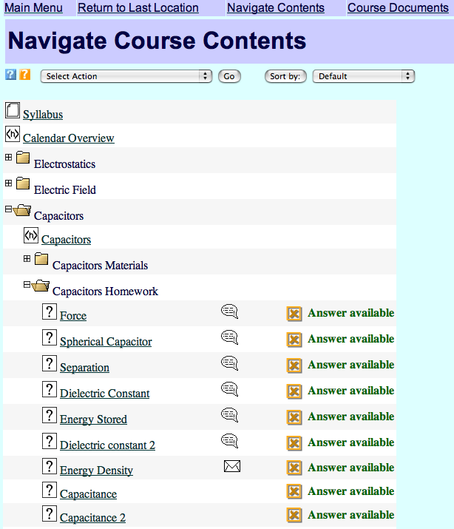
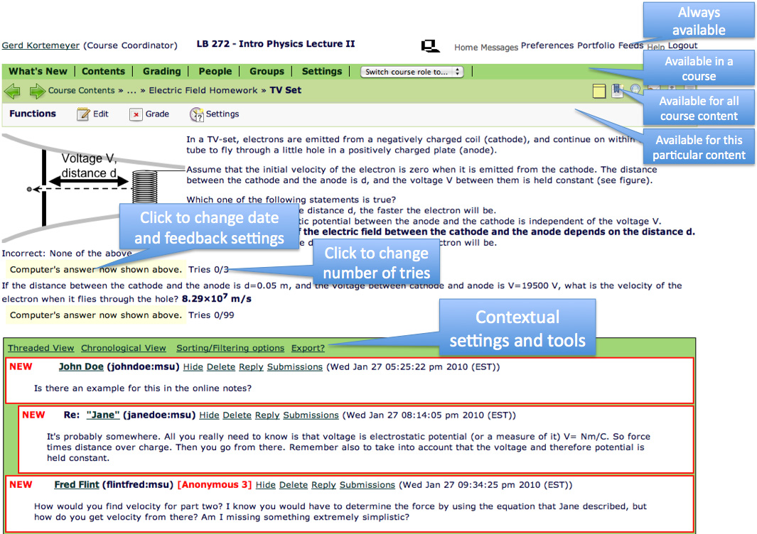
Clearly Defined Purpose

Slide 8
Clearly Defined Purpose
You cannot be all things to all people
Do not provide a random hodgepodge of “stuff”
Otherwise, your users might as well just surf the web
In LON-CAPA case: the decision makers (instructors) look for tested and trusted resources that they can put in front of their students

Slide 9
Be Selective
Be selective about whom you allow to contribute
In case of LON-CAPA,
only bona-fide schools, colleges, universities, and publishers can join the network
only faculty/instructors at participating institutions can contribute content
crackpots and folks with some random agendas damage your credibility – the agenda is education

Slide 10

Be Selective
High Schools, Colleges, and Universities
Canada: 6
Germany: 3
Turkey: 1
South Korea: 1
USA: 106
Switzerland: 1
Israel: 2
Brazil: 1
South Africa: 1
… plus grant projects and publishing companies.

Slide 11
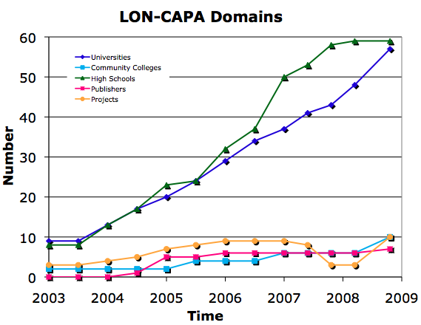
Be Selective
130 member institutions

Slide 12
Be Selective
Be selective about whom you allow to contribute – but then give them freedom
In case of LON-CAPA:
  No explicit peer-review
    hurdle to contributing
    bottleneck
  But: implicit peer-review through usage tracking
  Another instructor choosing a resource for his or her course is peer-review!

Slide 13
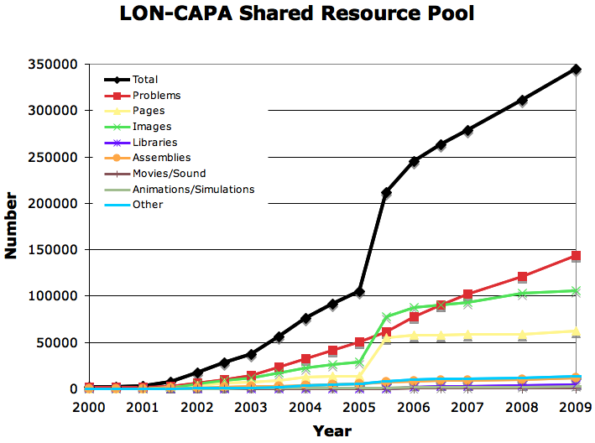
Be Selective
Free content - not counting commercial content
Shared content repository with almost 350,000 resources
Almost 150,000 online homework problems

Slide 14


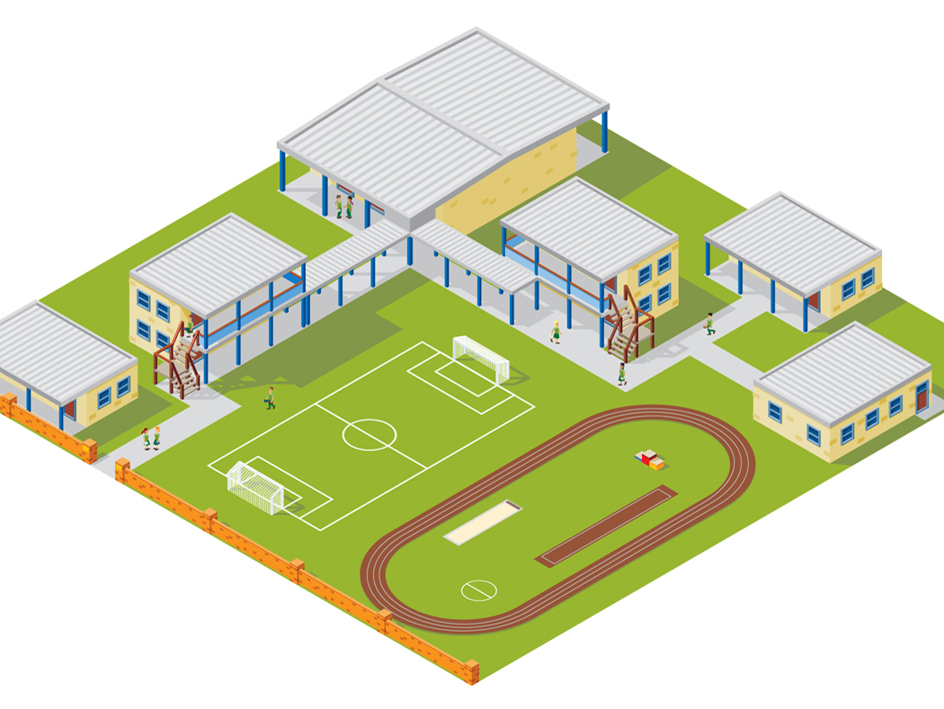



Distribute
WWW
Web
Instructor
Computer
Interserver
Campus A
Campus B
WWW
Campus C
Institutions
running their own
installations for their own teaching
Student Computer

Slide 15
Distribute
LON-CAPA is a “franchise” – local ownership
  For example, at MSU 11,000 student course enrollments per semester running out of LON-CAPA
  UIUC: 9,000 student course enrollments
  SFU, Ostfalia, Ohio U, …
Programmers and support staff paid by the partner institutions as part of their instructional support cost – that’s where the 4 fulltime and 3 parttime staff people come from
LON-CAPA development and support tied into universities’ core business

Slide 16
Distribute
Distributed at institutions:
  Programmers
  (open-source software platform)
  Scholarship
  Support
  “Marketing”

Slide 17
Share the wealth
Share the wealth – help your partner institutions get funding, publicity, etc
  Make platform and content available for free
  Grants do not need to come to you directly to help
  Let other institutions do connected scholarship
  Other people can do marketing for you

Slide 18
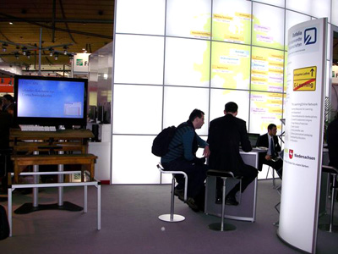
Share the wealth
Examples:
Current EUR 200,000 grant to partner university in Germany – MSU does not get one cent of that directly, but project benefits greatly
Current and past NSF-ASA and NSF-CCLI grants using LON-CAPA as platform – LON-CAPA benefits
German university paid for booth at CeBIT exhibit two weeks ago
Scholars at other universities publishing research papers and opinion pieces about LON-CAPA
Students at various institutions doing
thesis work on LON-CAPA
School offering paid professional
development on LON-CAPA to other
schools
Other universities hosting annual
conferences

Slide 19
Concrete Questions
Some concrete questions that came up at this workshop:
  What is the incentive for authors to contribute?
  Is there some direct and sustainable income stream?
Good questions!

Slide 20
How to Get Contributions
Need this for their own teaching, contributions not purely altruistic
Needs some critical mass of content:
  If instructors find 80% of what they want for their course, but are missing some concrete things, they might be very willing to just contribute that “missing piece.”
  Chicken before egg …

Slide 21
How to Get Contributions
Assurance that any content they generate today is going to keep being available
  Investment has to pay off when teaching the course again a year, two years, n years from now
  Provide security and stewardship for content
  We still support content written in 1993
  You are entrusted with that content!

Slide 22
How to Get Contributions
Faculty need to see impact:
  Faculty have some urge to “broadcast”
  They want to see things used
Show authors how
many students in
how many
courses at how
many institutions
used their stuff

Slide 23


How to Get Contributions
Campus A
Campus B
Course Management
Course Management
Resource Assembly
Resource Assembly
Shared Cross-Institutional
Digital Resource Library

Slide 24
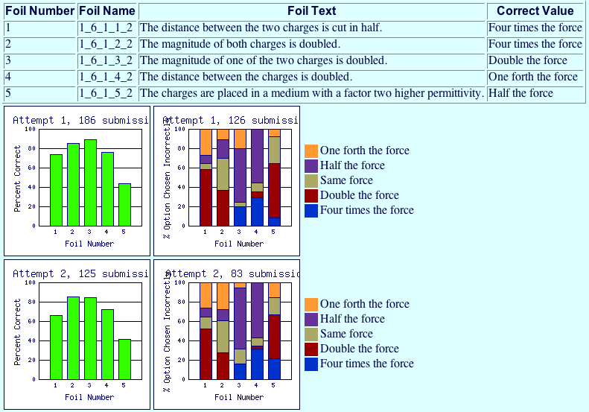
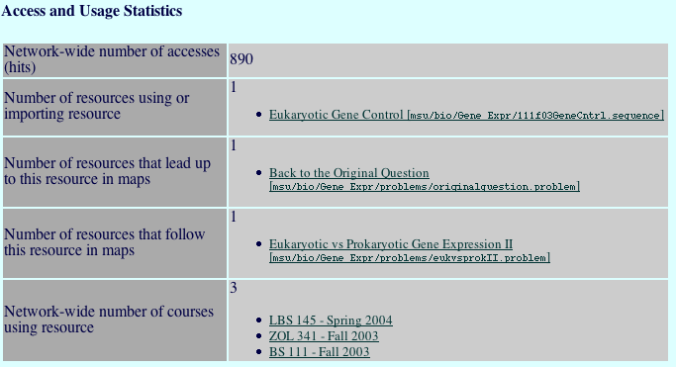
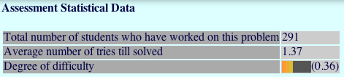
How to Get Contributions
Authors can see how their materials are performing

Slide 25
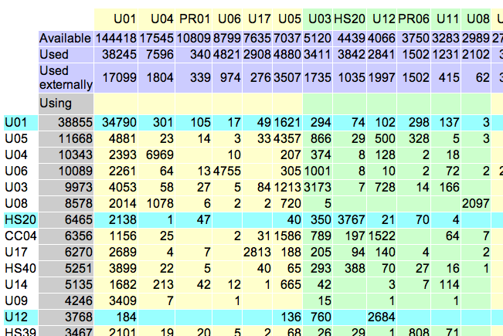
How to Get Contributions
Cross-institutional use

Slide 26
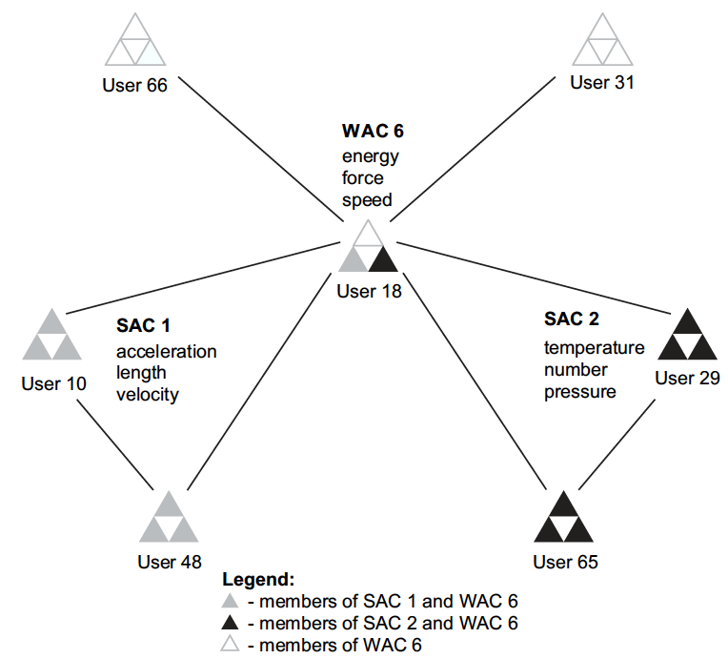
How to Get Contributions
Creates communities of practice!
Connects colleagues doing the same thing
Annual conferences and workshops

Slide 27
How to Get Contributions
Minimal effort to contribute materials
  Offers interface to enter detailed metadata, but not required
  Ability to assign cascading metadata to collections of resources
System continually collects metadata based on use
  Contexts
  Connections between resources

Slide 28
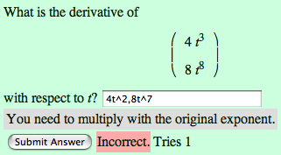
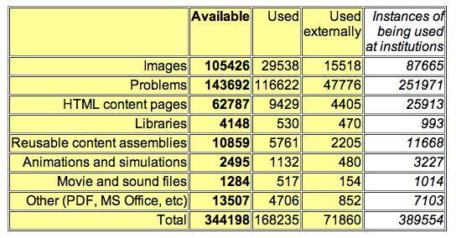
How to Get Contributions
Driving force: problems
<30% reuse
>80% reuse

Slide 29
Direct Sustainable Income
Direct sustainable income stream?
Do not want to charge for software
  Believe in open-source
Do not want to charge the students
  Education already expensive enough
Micropayment schemes
  Too cumbersome
  Possible conflicts with institutional intellectual property policies
  Textbook publishers don’t play
  Educational content has no monetary value: universities sell degrees, not education
Do not want to charge for service
  Institutions can run LON-CAPA completely for free

Slide 30
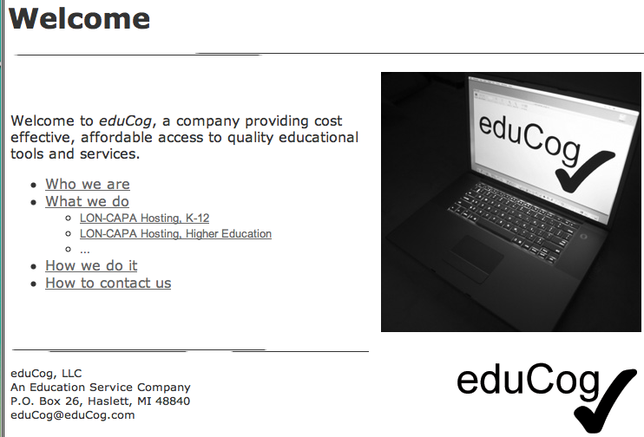
Direct Sustainable Income
Spin-Off: eduCog, LLC

Slide 31
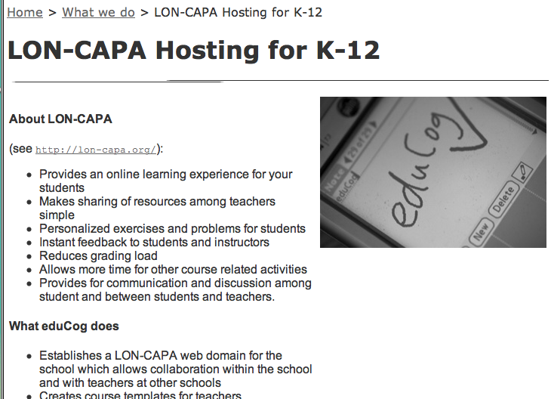
Direct Sustainable Income
Hosting of LON-CAPA for institutions that are unable or unwilling to run their own installation
Attractive since LON-CAPA is also complete course management system
(established cost center)
Constant income
stream from
low-cost hosting fees

Slide 32
Direct Sustainable Income
Textbook Publishers
Warning: complicated mechanism!
Publishers sell textbooks. Period.
Instructors are decision makers for several hundred sales at a time
Incentives for instructors: free ancillary materials, particularly online
homework

Slide 33
Direct Sustainable Income
Textbook publishers pay spin-off company for
coding ancillary materials
hosting ancillary materials
selectively open up these libraries for courses that adopted the textbook (digital rights management)
constant income stream: publishers intentionally make problem libraries incompatible between editions

Slide 34
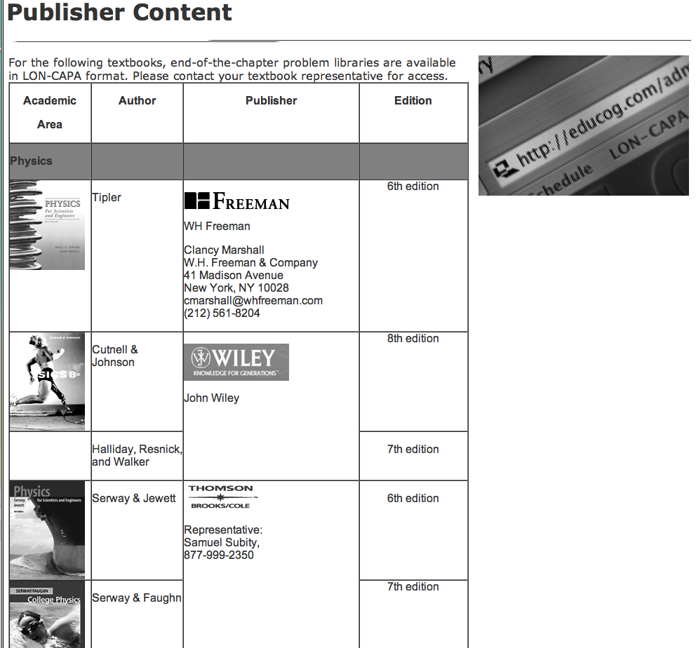
Direct Sustainable Income
Five major publishers

Slide 35
Summary
Sustainability is not easy to achieve
Select exactly what you do and what you don’t do, and do it well
  Be flexible if odd funding opportunities come up that support your mission
  Tie into institutions’ core business and established cost centers
  Don’t let random grant opportunities distract you from your mission – grant funding is nice, but not sustainable
Create community

