Slide 1


The LON-CAPA
Resource Sharing Network
Gerd Kortemeyer
Michigan State University

Slide 2
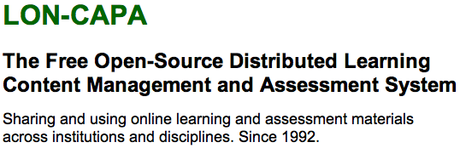
Experiences
The whole conference is about sharing content
No sense preaching to the choir
Thus:
What have we learned in 20 years?

Slide 3
Experiences
Focus on online educational resources for learners
  Not on research publications
  Not on guides on how to teach better
  Not digital versions of books
  Not collections of materials for lecture preparation
  Not data collections (except for learners to evaluate as part of their learning)
Compatible with OER idea
LON-CAPA: usually in course-context

Slide 4
Experiences
Focus on large enrollment introductory undergraduate courses and AP
courses at schools
  online
  hybrid
  online supplement or textbook replacement for traditional lectures
New in 2012: free open course
  2000 students in free online physics course
  http://relate.mit.edu/physicscourse
Faculty compiles content for students into courses

Slide 5
Conflict or Synergy?
Open Course Ware
?
?
?
granular
Courses
static?

Slide 6
Conflict or Synergy?
Open Course Ware
?
?
?
granular
Learning Content/Course Management
Courses
dynamic

Slide 7


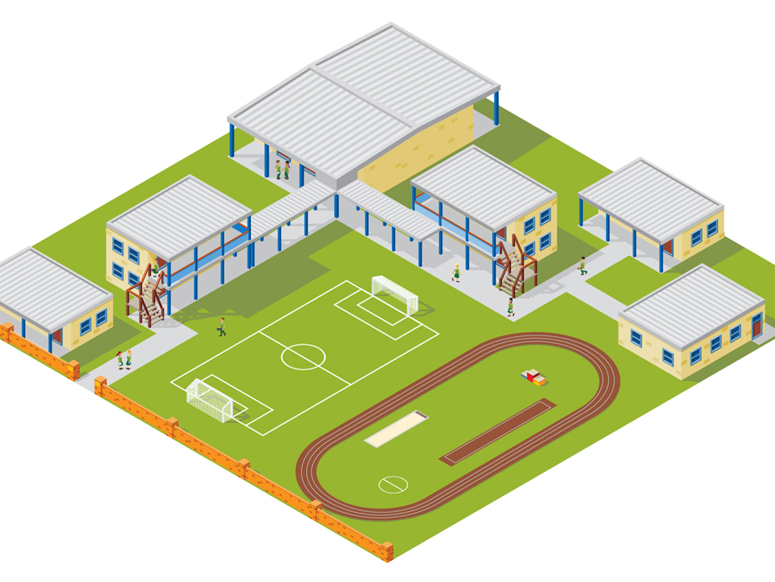



LON-CAPA Architecture
WWW
Web
Instructor
Computer
Interserver
Campus A
Campus B
WWW
Campus C
Inter-Institutional
Network of Servers Connecting Universities and Schools
Student Computer

Slide 8









LON-CAPA Architecture
Campus A
Campus B
Course Management
Course Management
Resource Assembly
Resource Assembly
Shared Cross-Institutional
Digital Resource Library

Slide 9

LON-CAPA Architecture
Campus A
Campus B
Course Management
Course Management
Resource Assembly
Resource Assembly
Shared Cross-Institutional
Digital Resource Library

Slide 10
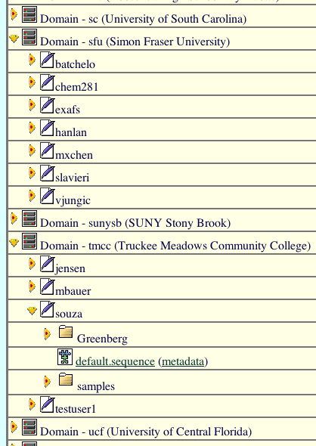
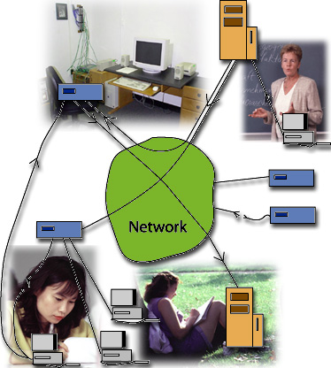
Shared Resource Library
The distributed network looks like one big file system

Slide 11
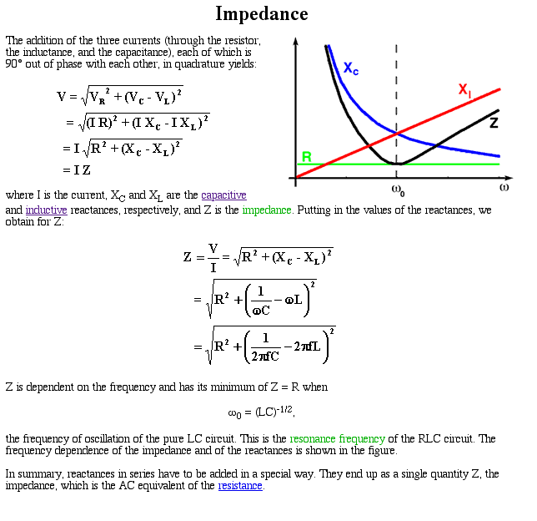
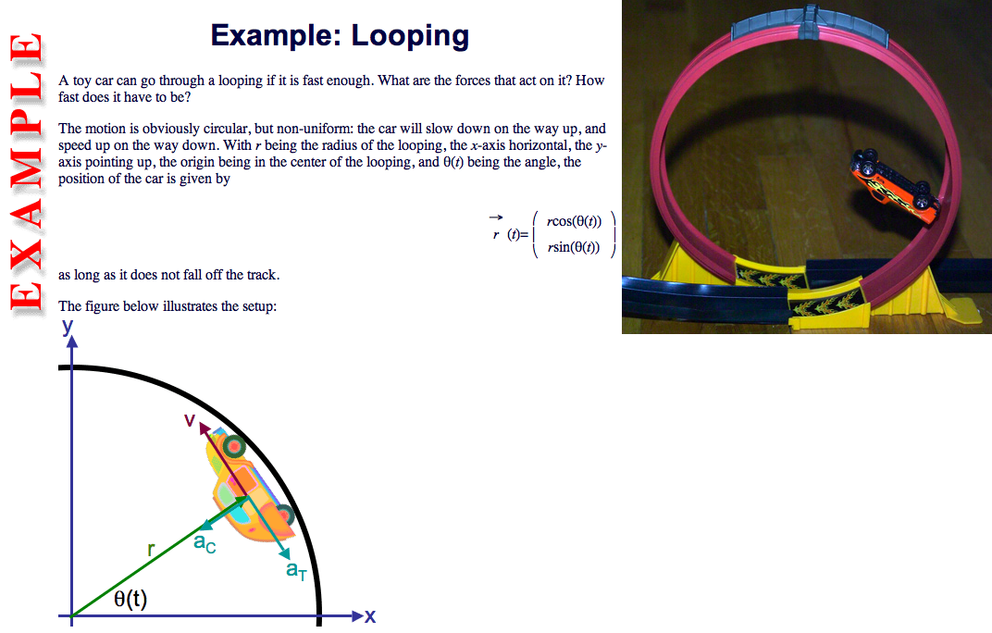
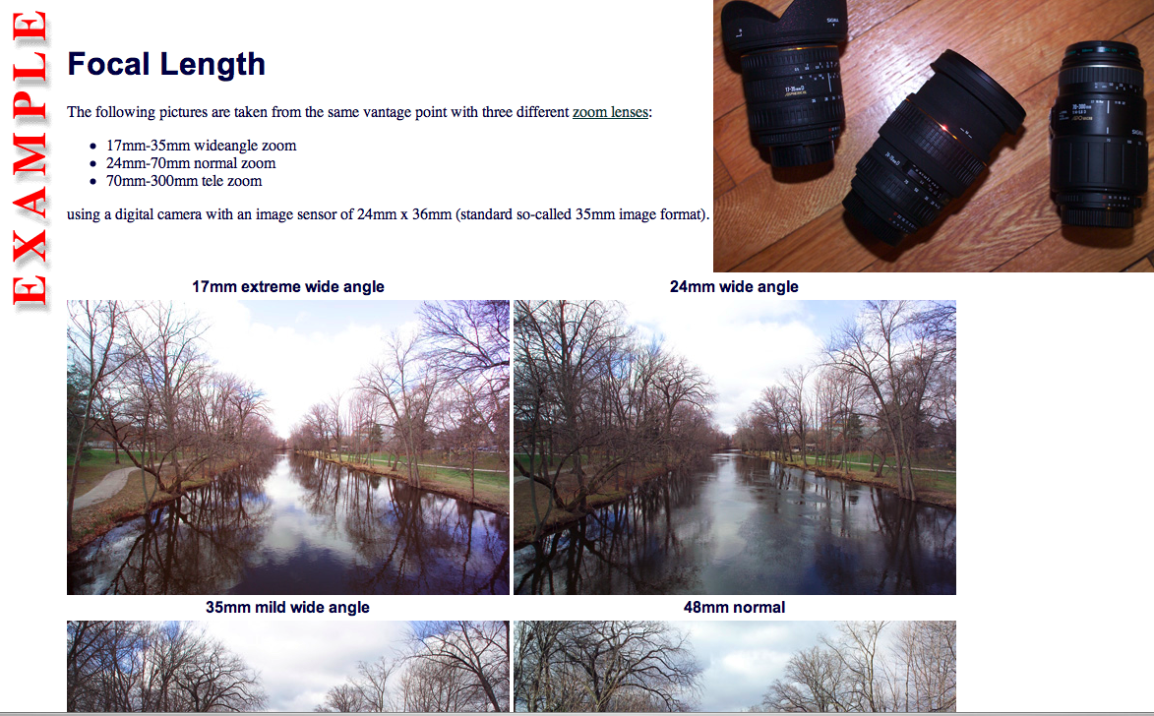
Shared Resource Library
Resources may be web pages …

Slide 12
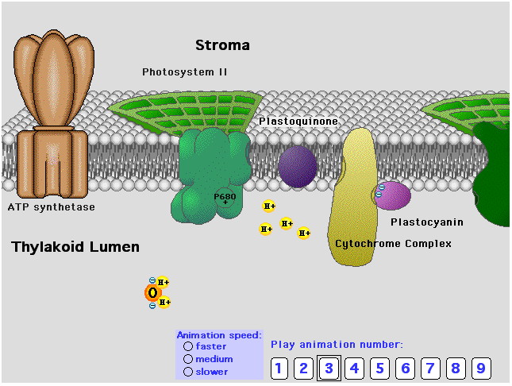
Shared Resource Library
… or simulations and animations …

Slide 13
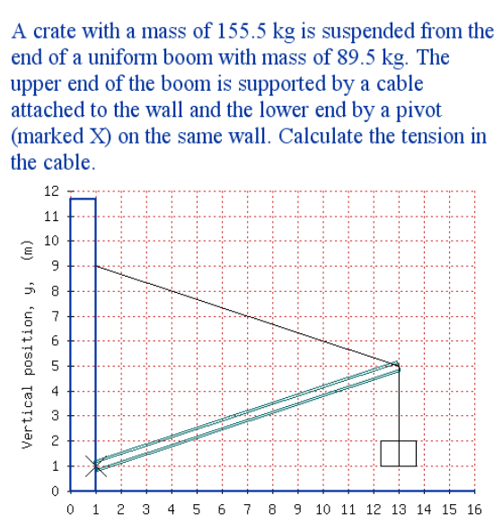
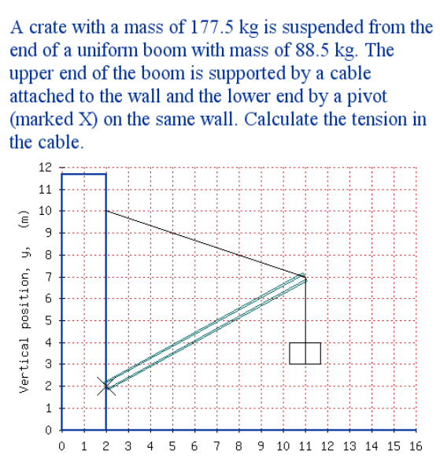
Shared Resource Library
… or this kind of randomizing online problems

Slide 14
LON-CAPA Architecture
Campus A
Campus B
Course Management
Course Management
Resource Assembly
Resource Assembly
Shared Cross-Institutional
Digital Resource Library

Slide 15
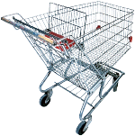
Resource Assembly
Take shopping cart to the supermarket

Slide 16
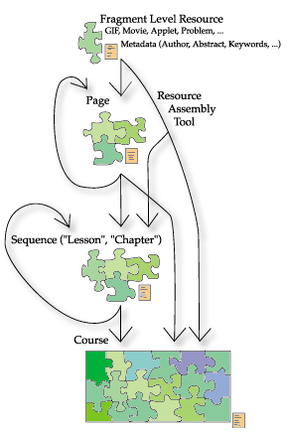
Resource Assembly
Nested Assemblies
No pre-defined levels of granularity („module“, „chapter“, etc)
  People can never agree what those terms mean
Re-use possible on any level
  Customize your table of contents

Slide 17

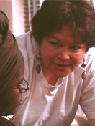
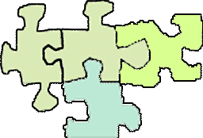

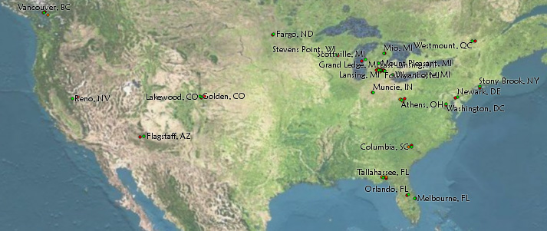



Resource Assembly
Writes module about
energy conservation
Compiles module about conservation laws
Writes module about
momentum
conservation
Uses whole
assembly
in his course

Slide 18
LON-CAPA Architecture
Campus A
Campus B
Course Management
Course Management
Resource Assembly
Resource Assembly
Shared Cross-Institutional
Digital Resource Library

Slide 19
Course Management
Posting of materials
Posting of homework
Discussions
Announcements
Portfolios
Scheduling
Gradebook
…

Slide 20
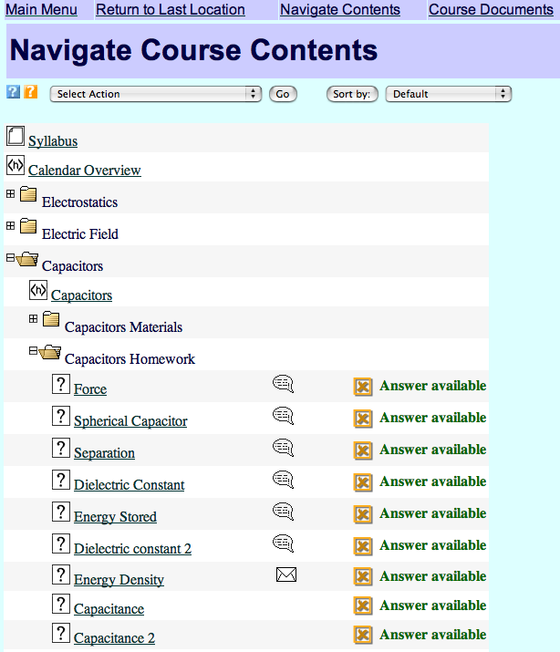
Course Management
Instructors can directly use the assembled material in their courses
  navigational tools for students to access the material
  access rights management
  timing
  contextual discussions and messaging

Slide 21
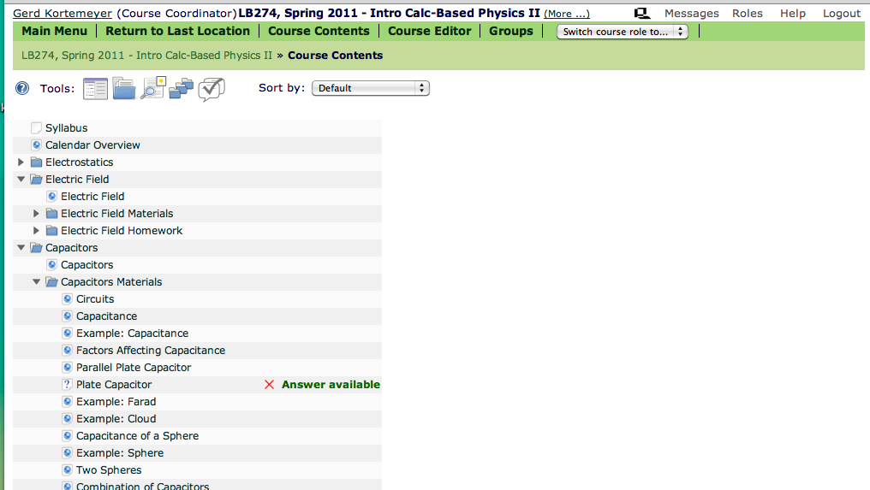
Course Management
Assembled structure turns into the course navigation
Organized around the content, not the resource type, e.g. embedded online assessment

Slide 22
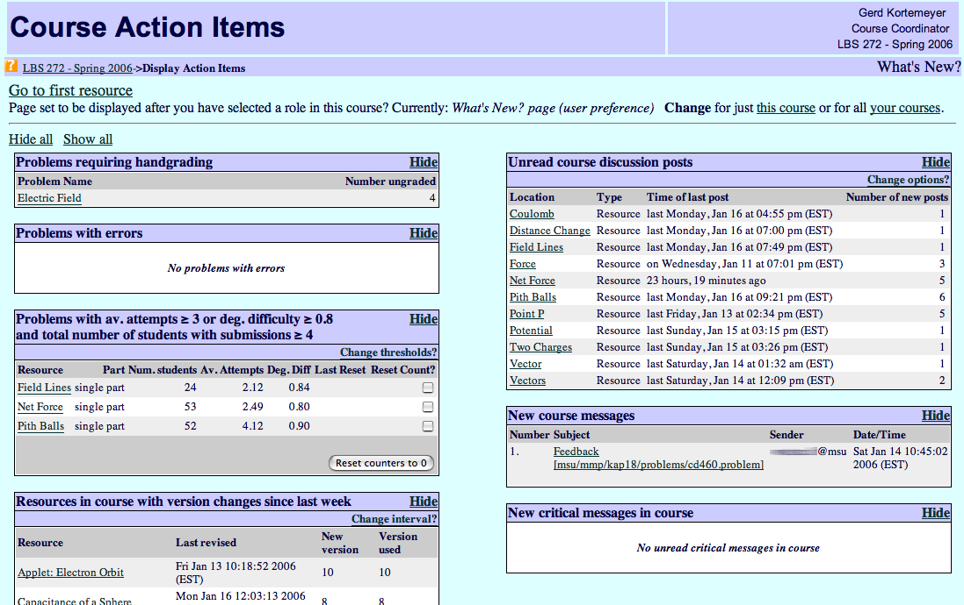
Course Management
Course overview/dashboard

Slide 23
LON-CAPA Architecture
Campus A
Campus B
Course Management
Course Management
Isn’t that rather monolithic?
Resource Assembly
Resource Assembly
Shared Cross-Institutional
Digital Resource Library

Slide 24
Dynamic Metadata
Campus A
Campus B
Course Management
Course Management
Resource Assembly
Resource Assembly
Advantage:
Feedback from all levels
The system gets to know the resources
Shared Cross-Institutional
Digital Resource Library

Slide 25
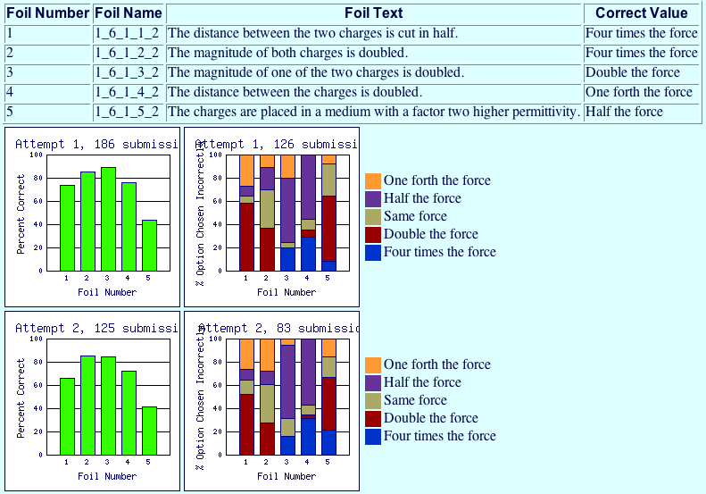
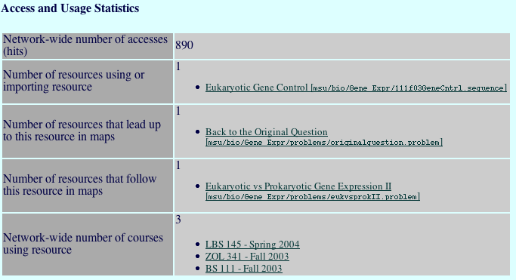
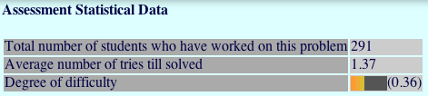
Dynamic Metadata
Dynamic metadata from usage
Assistance in resource selection („amazon.com“)
Quality control

Slide 26
Dynamic Metadata
More useful than static metadata
Authors
  spend hours writing beautiful resources
  do not spend five minutes to fill out even the most basic information
Dynamic metadata shows the resource “in action”

Slide 27
The LON-CAPA Community
Does this work?
Does it scale?

Slide 28
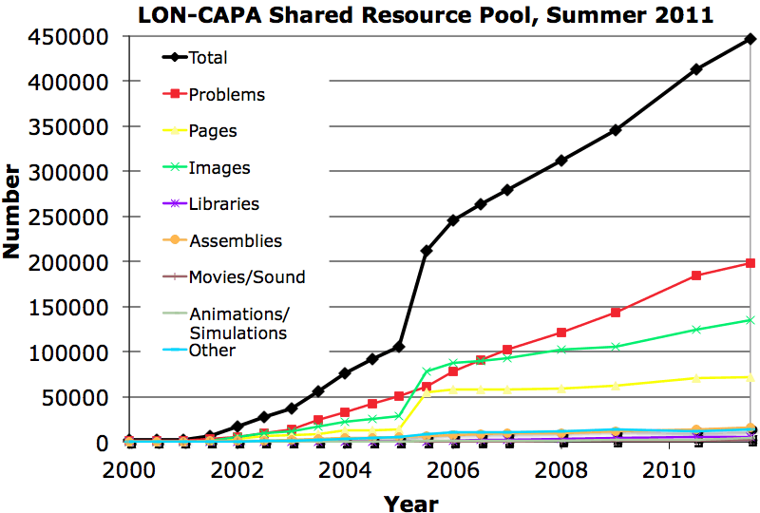
Shared Resource Library
Shared content repository with over 440,000 resources
Almost 200,000 online homework problems

Slide 29
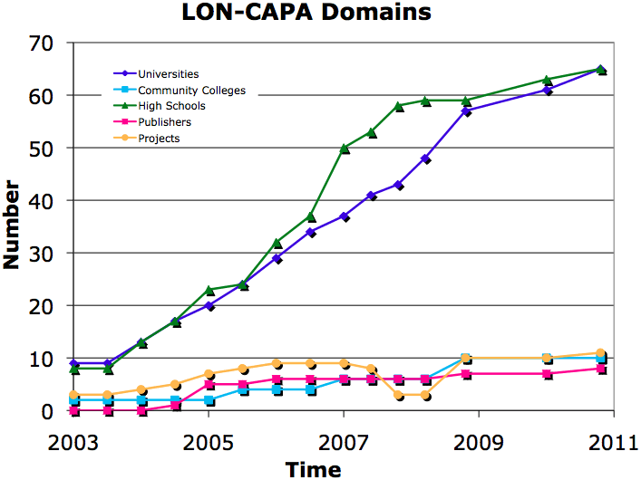
The LON-CAPA Community
160 member institutions

Slide 30

The LON-CAPA Community
High Schools, Colleges, and Universities
Great Britain: 1
Germany: 3
Canada: 7
Turkey: 1
South Korea: 1
USA: 108
Switzerland: 1
Israel: 2
Taiwan: 1
Nigeria: 1
Brazil: 2
South Africa: 1
… plus grant projects and publishing companies.

Slide 31
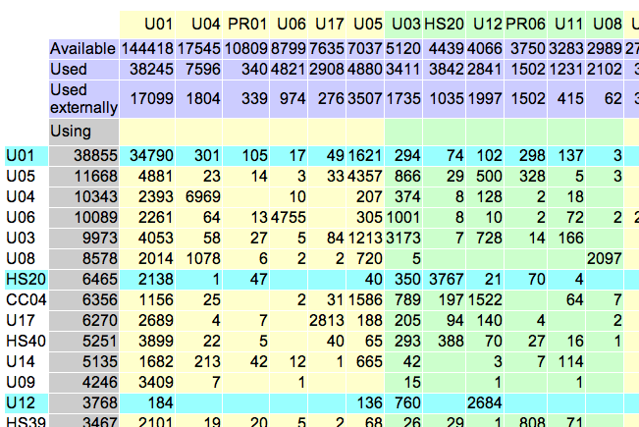
The LON-CAPA Community
Cross-institutional use
old data!

Slide 32
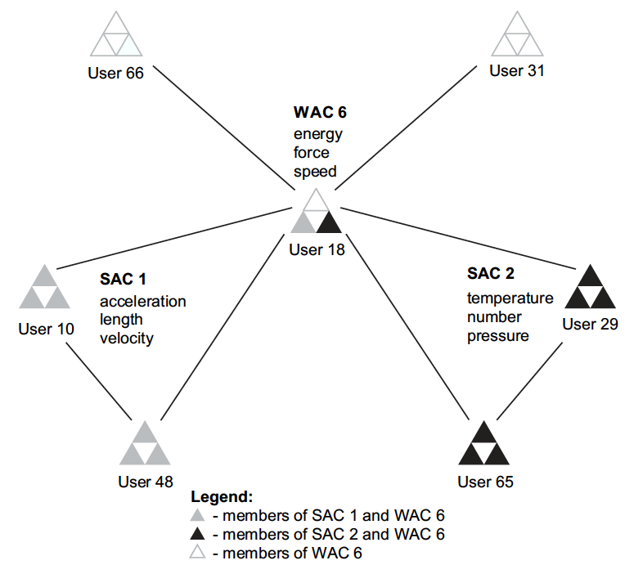
The LON-CAPA Community
Creates communities of practice!
Connects colleagues doing the same thing

Slide 33
Synergy
How can all of this benefit the OER Community?
  Dynamic platform to assemble, remix, and deploy OER content
  Built-in course management
    No download
    No content cartridges
  Learning content management
    Search
    Versioning
    Recommendations
  Digital Rights Management
    Commercial, licensed, and open content can co-exist in the same pool
    Expand to accommodate Creative Commons
    (was not around 20 years ago!)

Slide 34
Synergy
Build a distributed OER infrastructure
WWW
Web
Taking for-credit course
Assembling
materials
Interserver
Campus A
licensed
open
Campus B
WWW
Campus C
Just browsing
Taking free course

Slide 35
Thank you!
Thank you!
Gerd Kortemeyer
Michigan State University
http://www.lite.msu.edu/kortemeyer/
korte@lite.msu.edu

