Slide 1
Assessment in Online Courses
Gerd Kortemeyer
Michigan State University
Workshop Access
https://s10.lite.msu.edu/
Username: the email address with which you registered, all lowercase
Password: APS/AAPT
APS/AAPT 2013
Department Chairs Conference and Workshop

Slide 2
Background - Myself
Have run
  completely online large enrollment algebra-based physics courses
  completely online physics preparation courses
    “remedial” math, etc.
  blended 120-student calculus-based physics courses
Director of LON-CAPA and CourseWeaver Projects

Slide 3
Background – Physics at MSU
  MSU has been running completely online and blended large enrollment physics courses for over a decade
    Like many other departments, way beyond the “bubble”
    Essential and integral part of our curriculum
    “Online” is more than just MOOCs
  The courses that I have been teaching did not use a printed textbook

Slide 4
Background - Platform
LON-CAPA
Free open-source system
Has been used for almost 8000 courses at 160 institutions
Combines granular reading materials and assessment resources into online coursepacks
All content shared

Slide 5
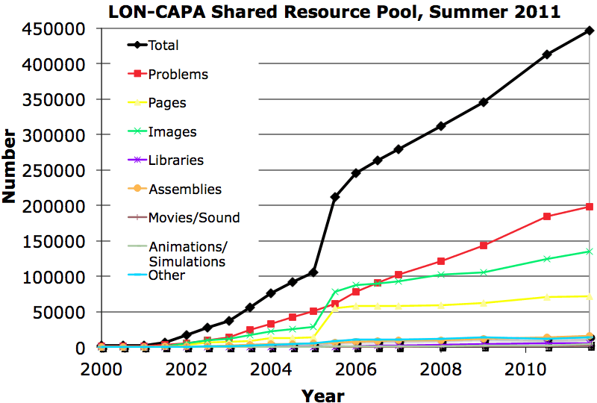
Background - Platform
Over 440,000 resources, text and assessment combined
200,000 online assessment problems

Slide 6
Background - Platform
Every student gets a different version of the same problem
  Different numbers, graphs, formulas, options, images, movies
  Students can collaborate, but not simply copy answer

Slide 7
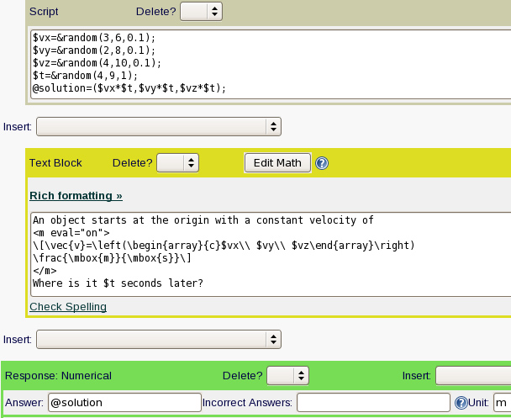
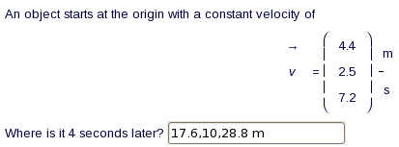
Background - Platform
Simple numerical response

Slide 8
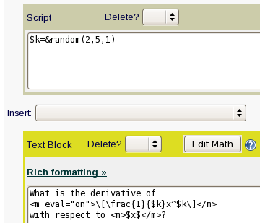


Background - Platform
Different formulas, same concept

Slide 9
Background - Platform
Different formulas, infinitely many correct answers

Slide 10
Background - Platform

Slide 11
Background - Platform

Slide 12
Background - Platform
Lifting/lowering,
speeding up/slowing down,
different numbers

Slide 13
Background - Platform
Same options, but different one is correct
Need to change this, too

Slide 14
Background - Platform
Using answer provided by learning in subsequent part

Slide 15
Background - Platform
Two ways how
the paper could
slide off the fridge:
Magnet slides off
paper
Paper and magnet
slide off fridge
Depending on
values, one or the
other decides.

Slide 16
Assessment
Assessment: Feedback to learners and instructors
Formative assessment:
  Students can keep track of their own learning
    Students do not fall behind
  Instructors keep track of their students’ learning
    Instructors can adapt the teaching to the learning
Summative assessment: exams
  Technology allows for frequent exams

Slide 17
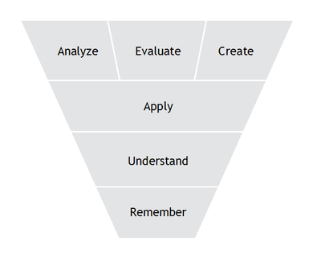
Assessment
Embedded and integrated into instruction
  Bloom’s Taxonomy
Projects, papers
End-of-chapter questions, exams
Embedded reading questions

Slide 18
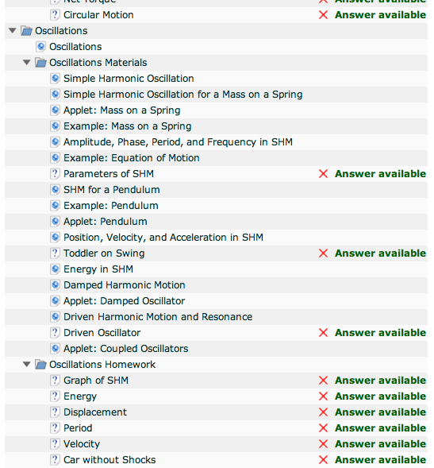
Assessment
Teaching and assessment combined
  Low Bloom level embedded into reading
  Higher level as homework, later duedate

Slide 19
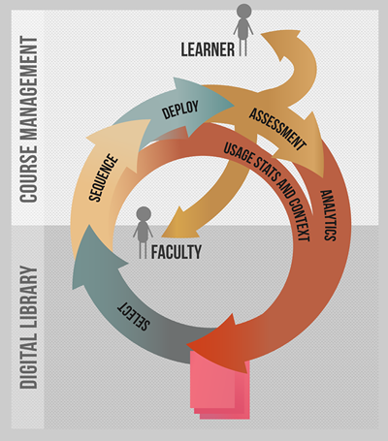
Assessment
Feedback at every level to
  learner
  instructor
  author

Slide 20
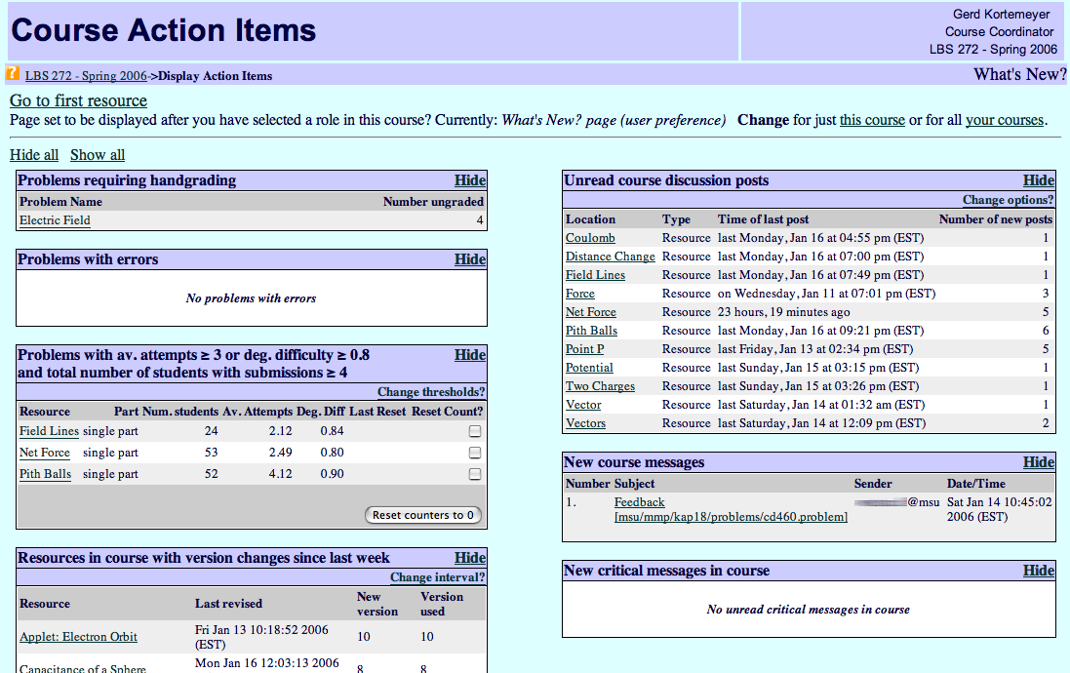
Feedback
Discussions
Difficult problems

Slide 21
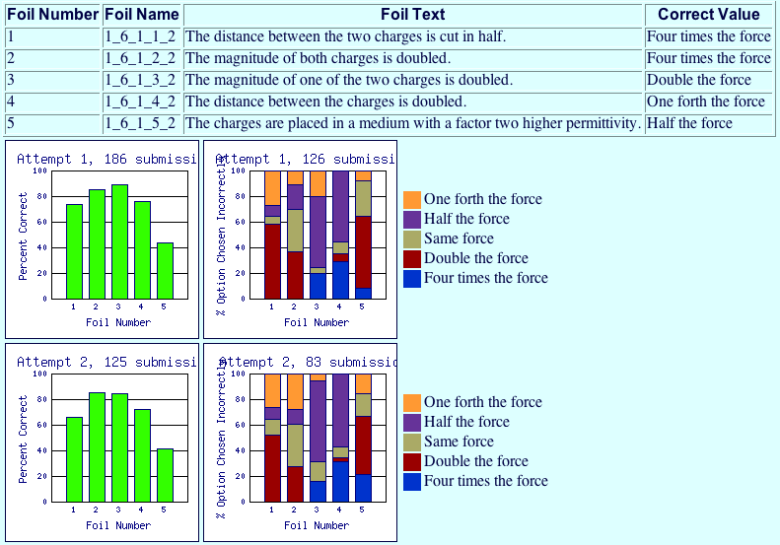
Feedback

Slide 22
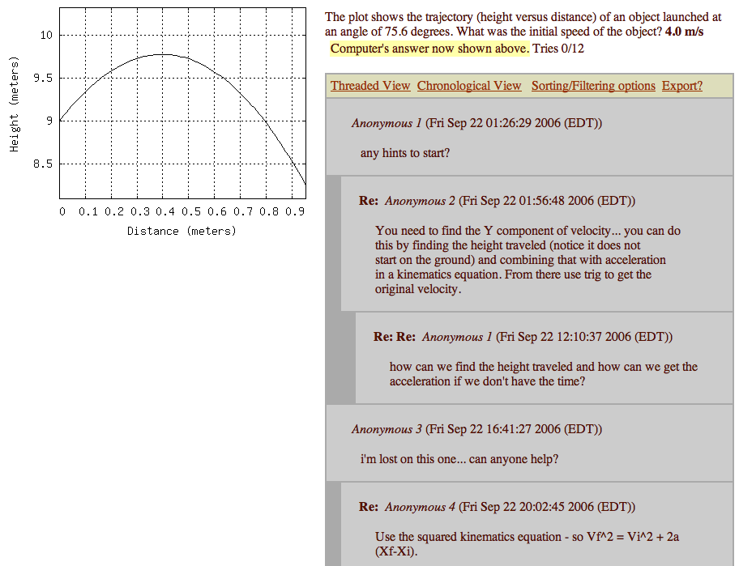
Feedback
Discussions
Encouraged, since all students have different versions.
Feedback and peer-instruction.

Slide 23
Good and not-so-good behavior
Self-reported: what do students do?
Gerd Kortemeyer, Gender differences in the use of an online homework system in an introductory physics course, Phys. Rev. ST Phys. Educ. Res. 5, 010107 [8 pages] (2009)

Slide 24
Good and not-so-good behavior
Gerd Kortemeyer and Peter Riegler, Large-Scale E-Assessments, Prüfungsvor- und -nachbereitung: Erfahrungen aus den USA und aus Deutschland, Zeitschrift für E-Learning, Volume 5, Issue 1, (2010)
Guessing
Time it takes to read problem
1 min
1 hr

Slide 25
Good and not-so-good behavior
Students do not always take optimal advantage of
  the offered formative assessment
    more in a later session
  the online materials
But in spite of that: it works, mostly!

Slide 26
Learning Success
In several semesters, gave same or similar final exams for blended and completely online sections
  Controlled environments for all sections
    Bubble sheet in-class
    External proctors the exception for completely online students, most took in-class exams
What do you think was the outcome?

Slide 27
Learning Success
The online course did slightly better
(large numbers, so even significantly)
  In other words: traditional lecture was not helpful
    Caveat: these students were self-selected
    Important: this was not my course ☺
Now using clickers and PER in lecture, which hopefully would shift the result

Slide 28
Learning Success
Traditional lectures:
  Fun for us, since we like to hear ourselves talk
  Students might think they make a difference
    But they don’t
  And yes, even the most charismatic lecturer cannot bring about better learning
    Only more excitement and appreciation for the subject
      Not to be underestimated!
But in the end, the learner has to do the hard work
  Thus, formative assessment!

Slide 29
Learning Success
On the other hand, online assessment does make a difference
Rewind way earlier, over a decade, before the department was lon-capsized

Slide 30
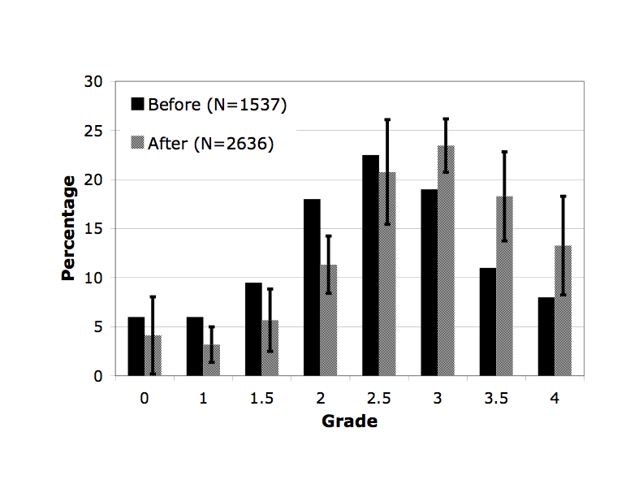
Learning Success
Intro Physics for Scientists and Engineers
Moved to blended format
Grades in years before and after online homework

Slide 31
Learning Success
Mostly helped students who are on the brink of failing the course.
Fail

Slide 32
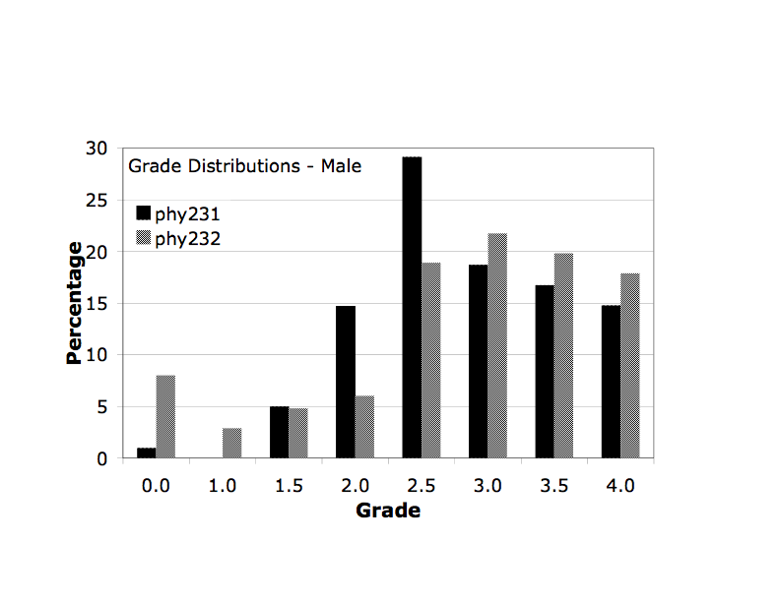
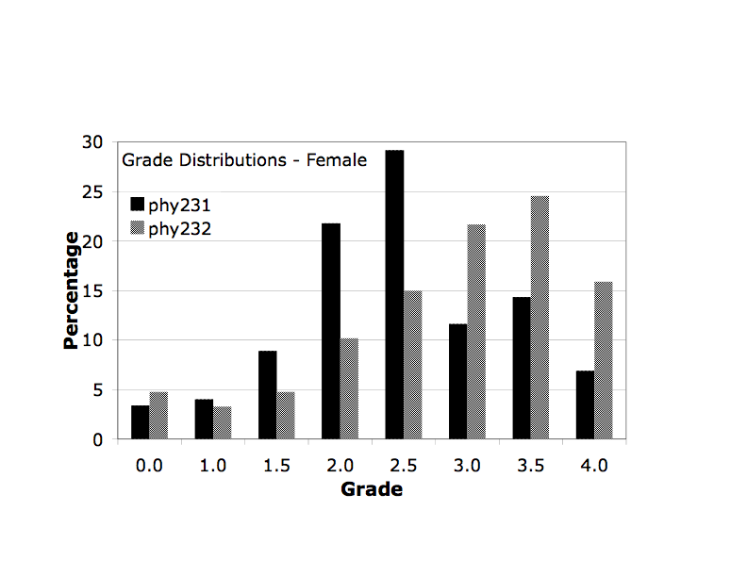
Learning Success
Gender-specific
First semester (black):
  No online homework
  Gender gap
Second semester
(gray):
  With online homework
  Less gender-gap

Slide 33
Summary
Traditional lectures are useless
Formative assessment is good

Slide 34
Thank you!
Gerd Kortemeyer
kortemey@msu.edu
Workshop Access
https://s10.lite.msu.edu/
Username: the email address with which you registered, all lowercase
Password: APS/AAPT

