Slide 1

Introduction to LON-CAPA
May 13th, 2010
Dalhousie University
Gerd Kortemeyer
Michigan State University

Slide 2
Overview
LON-CAPA is a system for
Course Management, for example:
  posting materials
  discussions
  announcements
  grade book
Learning Content Management, for example:
  storing online content for re-usage
  managing access rights
Assessment, for example:
  Homework
  Tests

Slide 3
Overview
LON-CAPA is a system for
Course Management, for example:
  posting materials
  discussions
  announcements
  grade book
Learning Content Management, for example:
  storing online content for re-usage
  managing access rights
Assessment, for example:
  Homework
  Tests
Many people
know LON-CAPA
only for this!

Slide 4
Overview
I will start with assessment
I will then hopefully show you why the other components are useful

Slide 5
Assessment
Assessment: Feedback to learners and instructors
Formative assessment:
  Students can keep track of their own learning
    Students do not fall behind
  Instructors keep track of their students’ learning
    can adapt the teaching to the learning
Summative assessment: exams
  Technology allows for frequent exams

Slide 6
Assessment
Pre-Class Questions
  Students being prepared for lecture
  Just-In-Time Teaching
In-Class Questions
  Clickers
Post-Class Questions
  Homework
  Online Discussions, Helprooms
  Exams
Does this even work?
How is this realistically possible?
  That’s where course and learning content management come in!
Lecture
?

Slide 7
Pre-Class Questions
Students being prepared for lecture
Just-In-Time Teaching

Slide 8
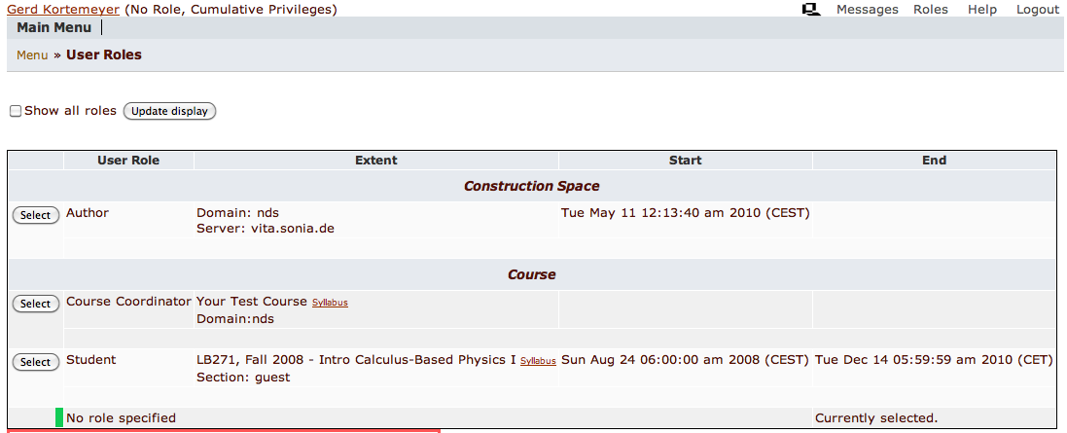
Pre-Class Questions

Slide 9
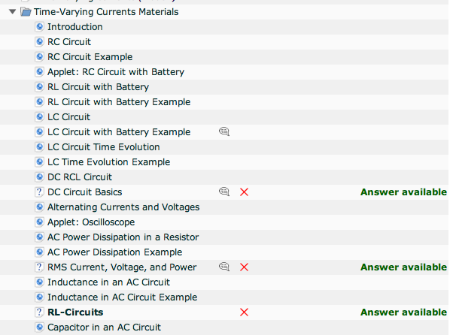
Pre-Class Questions
Easy questions embedded into content
Due before lecture

Slide 10
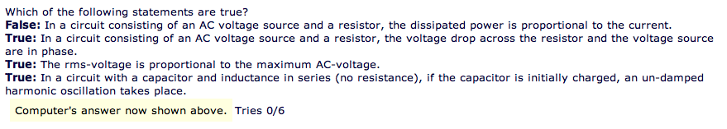
Pre-Class Questions
Make sure students read materials
Questions can be answered just based on the readings
Students come prepared

Slide 11
Just-In-Time
Adapt lecture to student difficulties
When I looked at your homework this morning, I saw that all of you have understood quantum field theory, but many of you still have problems with long division. So this morning, we will …

Slide 12
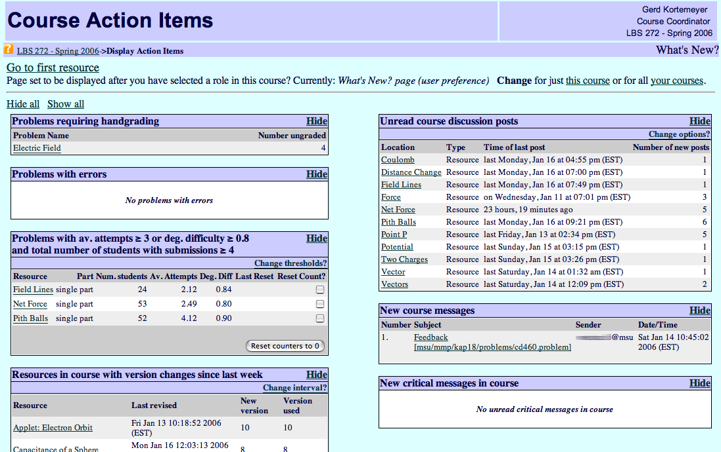
Just-In-Time
Discussions
Difficult problems

Slide 13
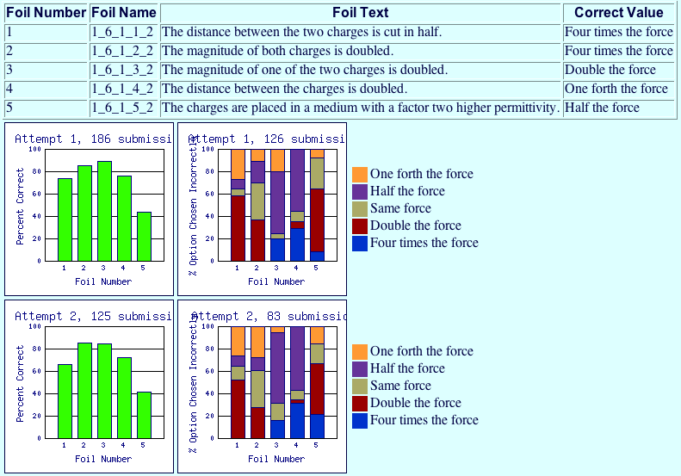
Just-In-Time

Slide 14
In-Class Questions
Clickers

Slide 15
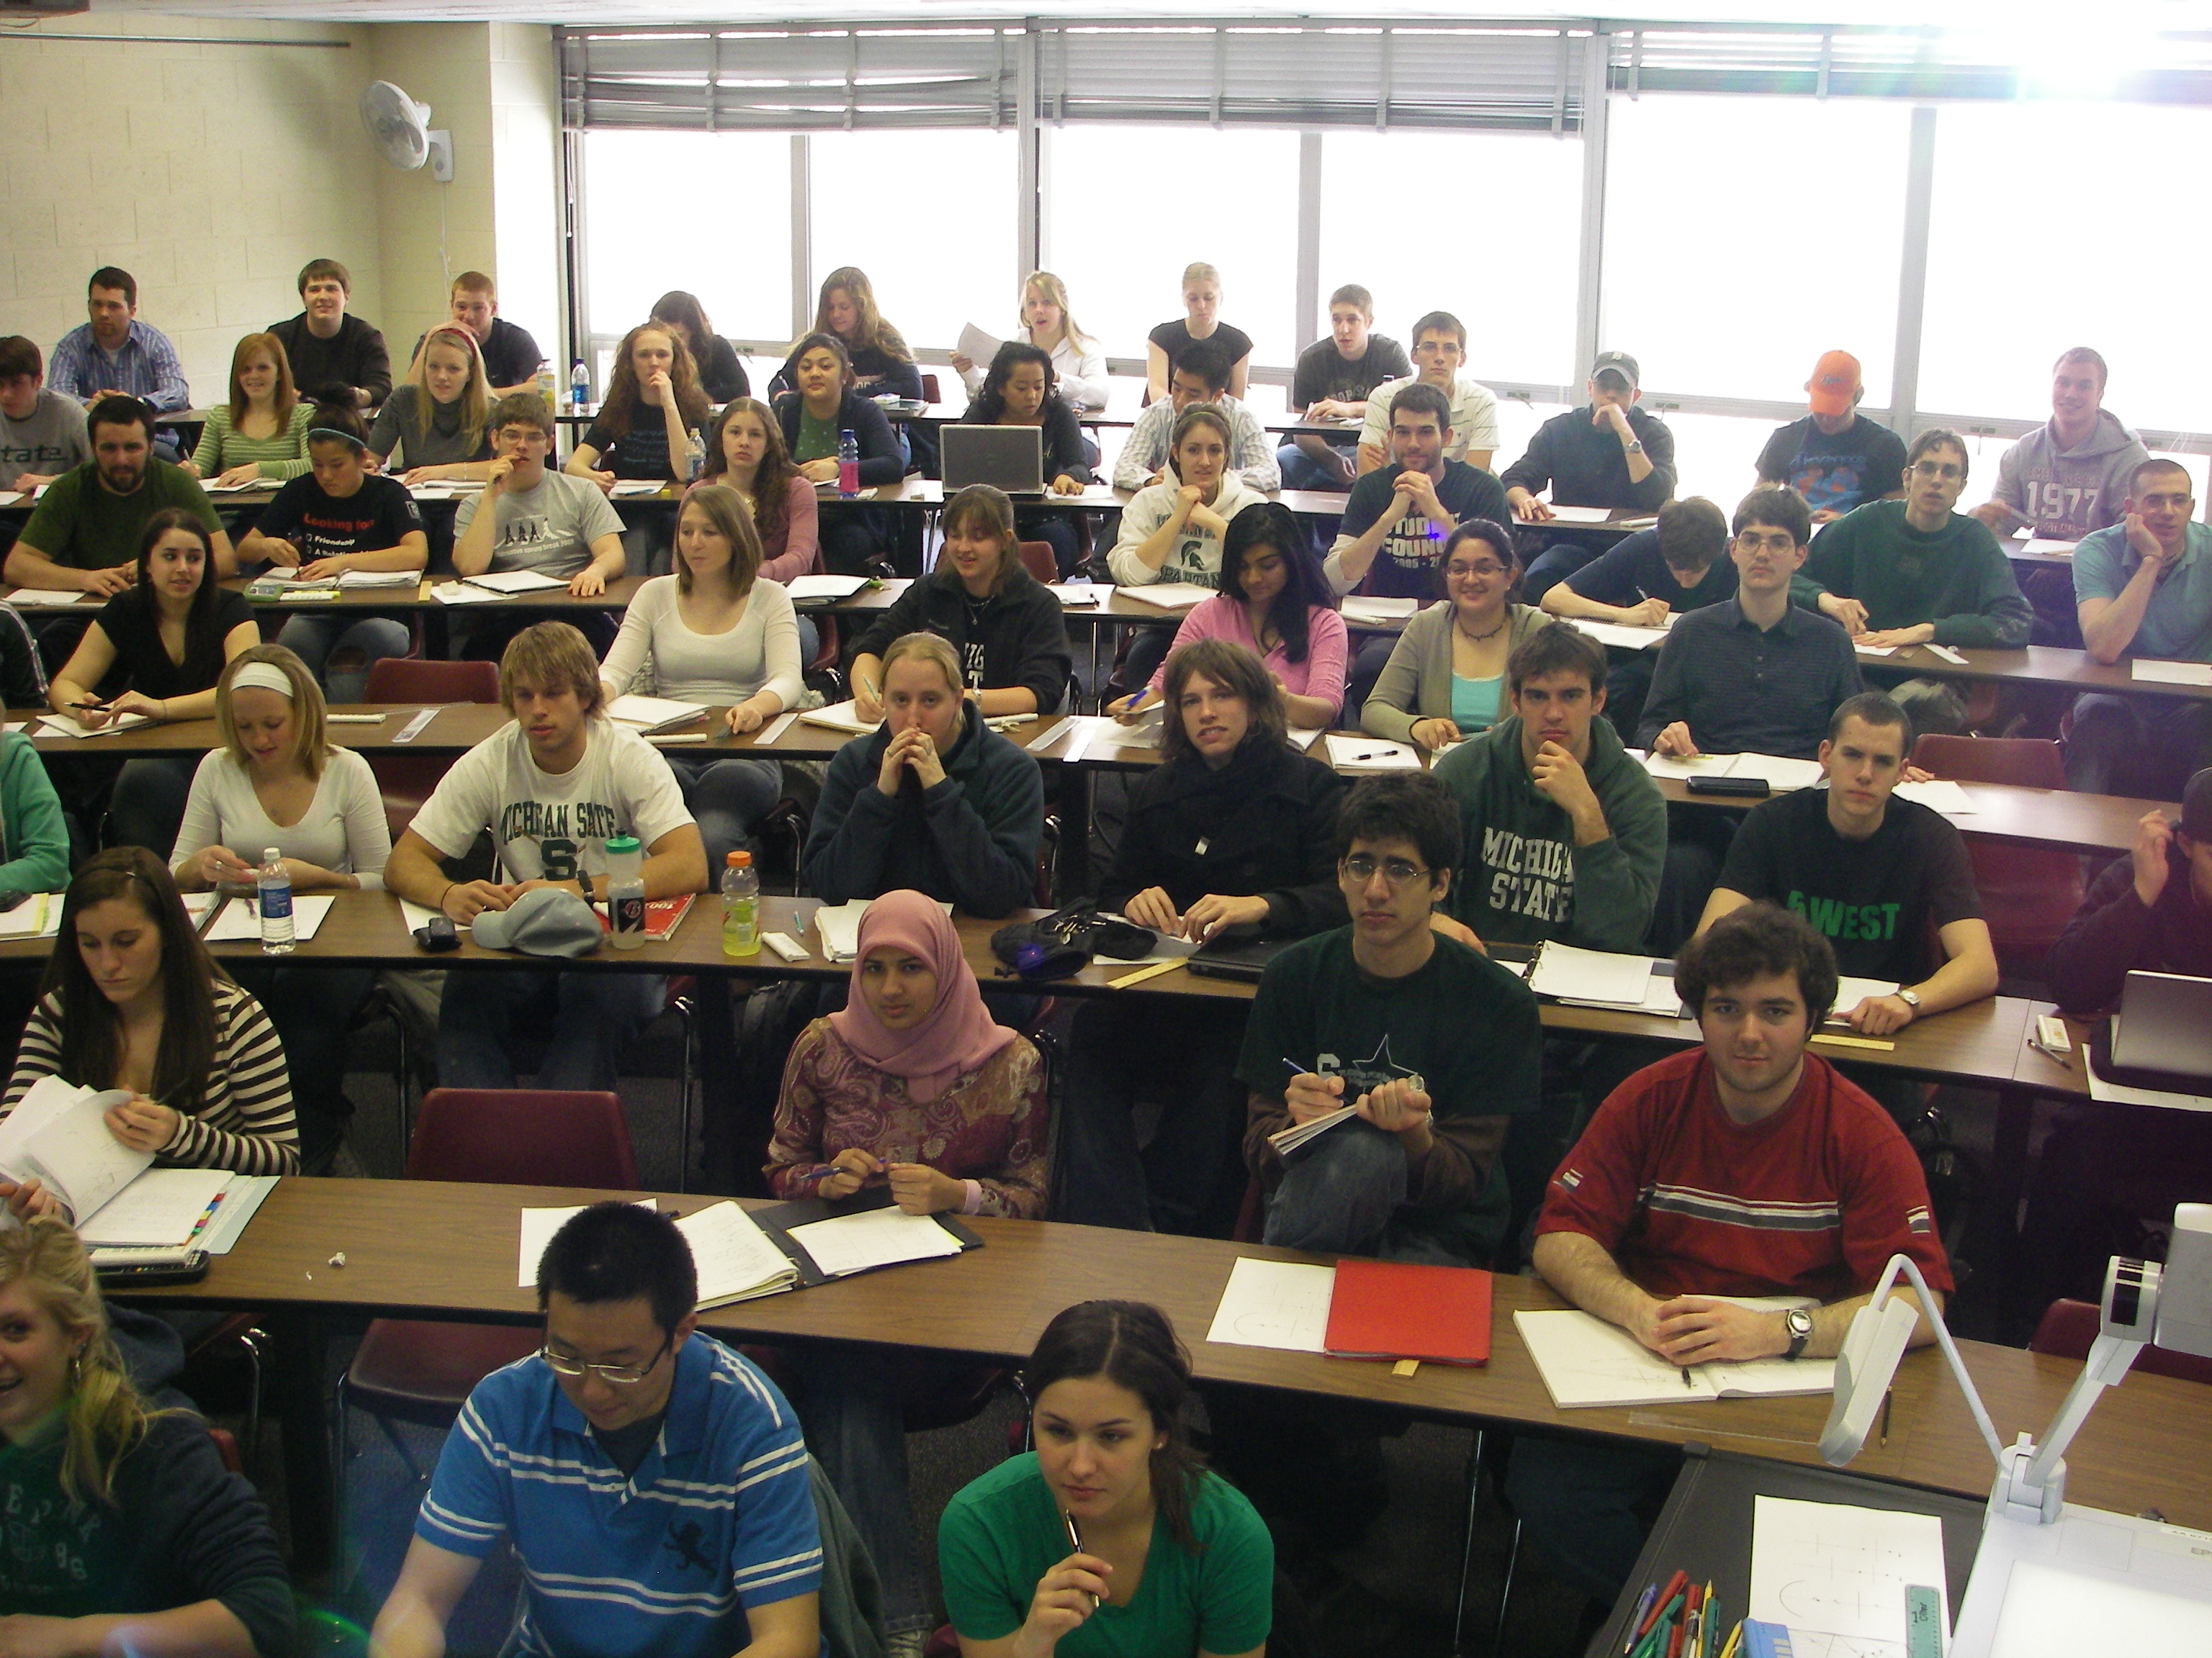
Clickers
That’s clear – no, wait …
Doesn’t he get that we don’t get it?
Yawn!
Looks like everybody but me understands this!
I wonder what’s for lunch

Slide 16
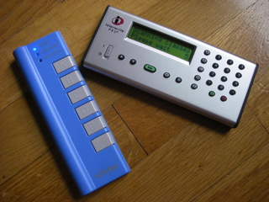
Clickers
RF devices
One per student
Students can answer questions during lecture

Slide 17
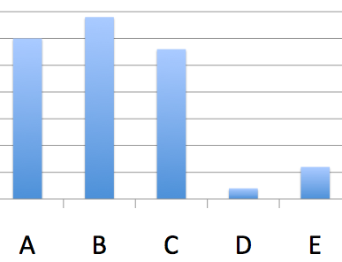
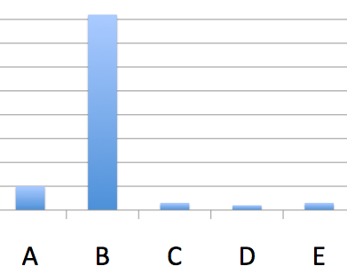
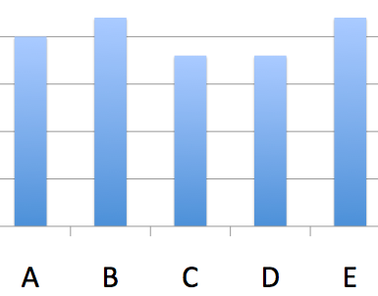
Clicker
Lecture progress depends on voting outcome
  Explain again
  Go on
  Let students discuss
  and vote again

Slide 18
Clicker
Peer-Instruction
Students can sometimes explain concepts better than us to their peers
  We have forgotten what we initially struggled with
Students learn while explaining

Slide 19
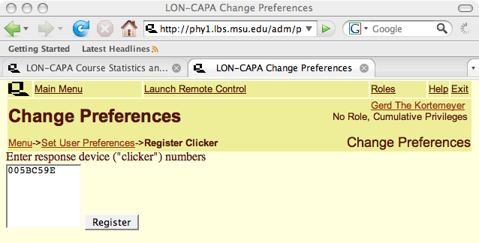
Clicker
Students register in LON-CAPA

Slide 20
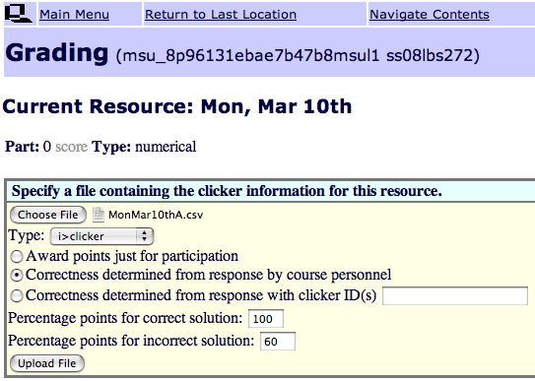
Clicker
Give credit for correct and for incorrect answers

Slide 21
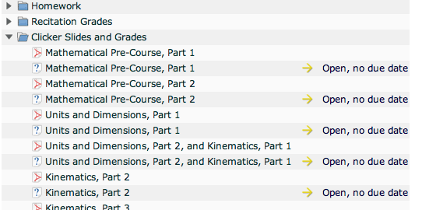
Clicker
Embedded in course, alongside slides

Slide 22
Post-Class Questions
Homework
Helprooms
Exams

Slide 23
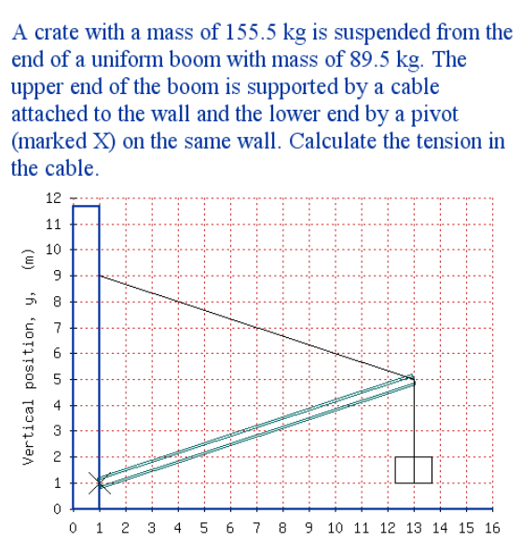
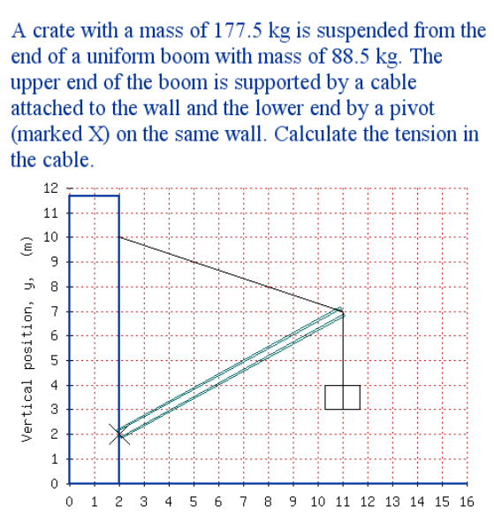
Homework
More sophisticated highly randomizing problems

Slide 24
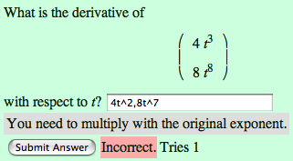
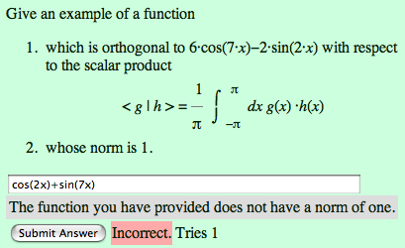
Homework
…special emphasis on math
  including support of
    LaTeX
    Maxima
    R

Slide 25
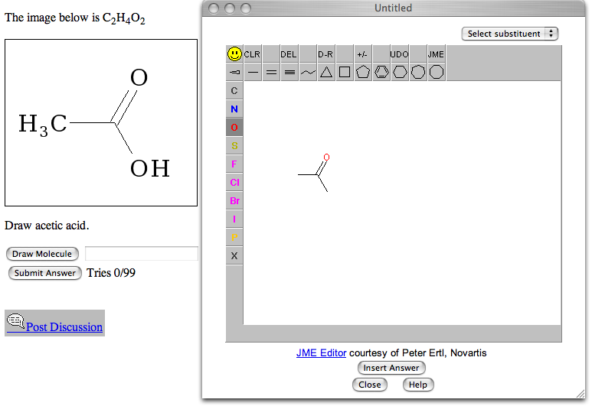
Homework
… chemistry …

Slide 26
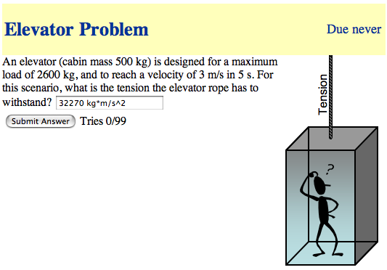
Homework
… physical units …

Slide 27
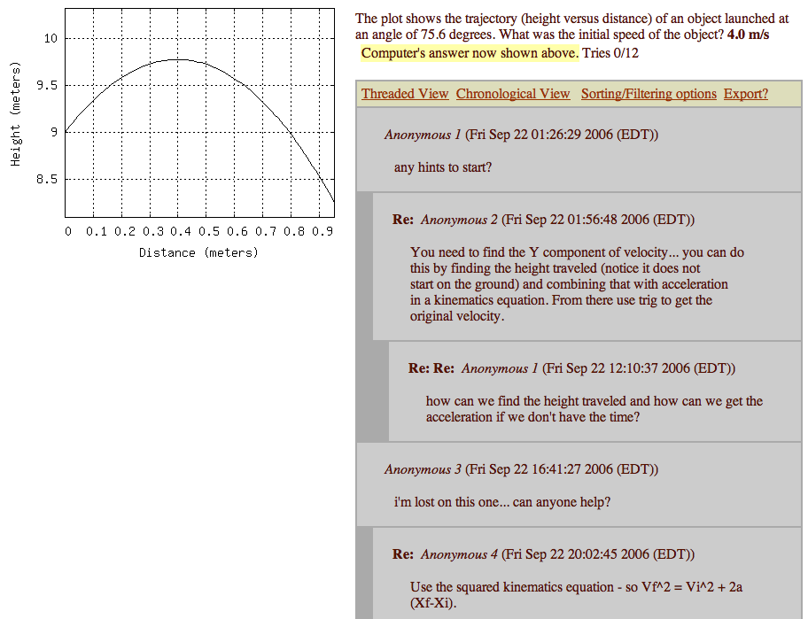
Online Discussions
Discussions
Encouraged, since all students have different versions.
Again: Peer-Instruction.

Slide 28
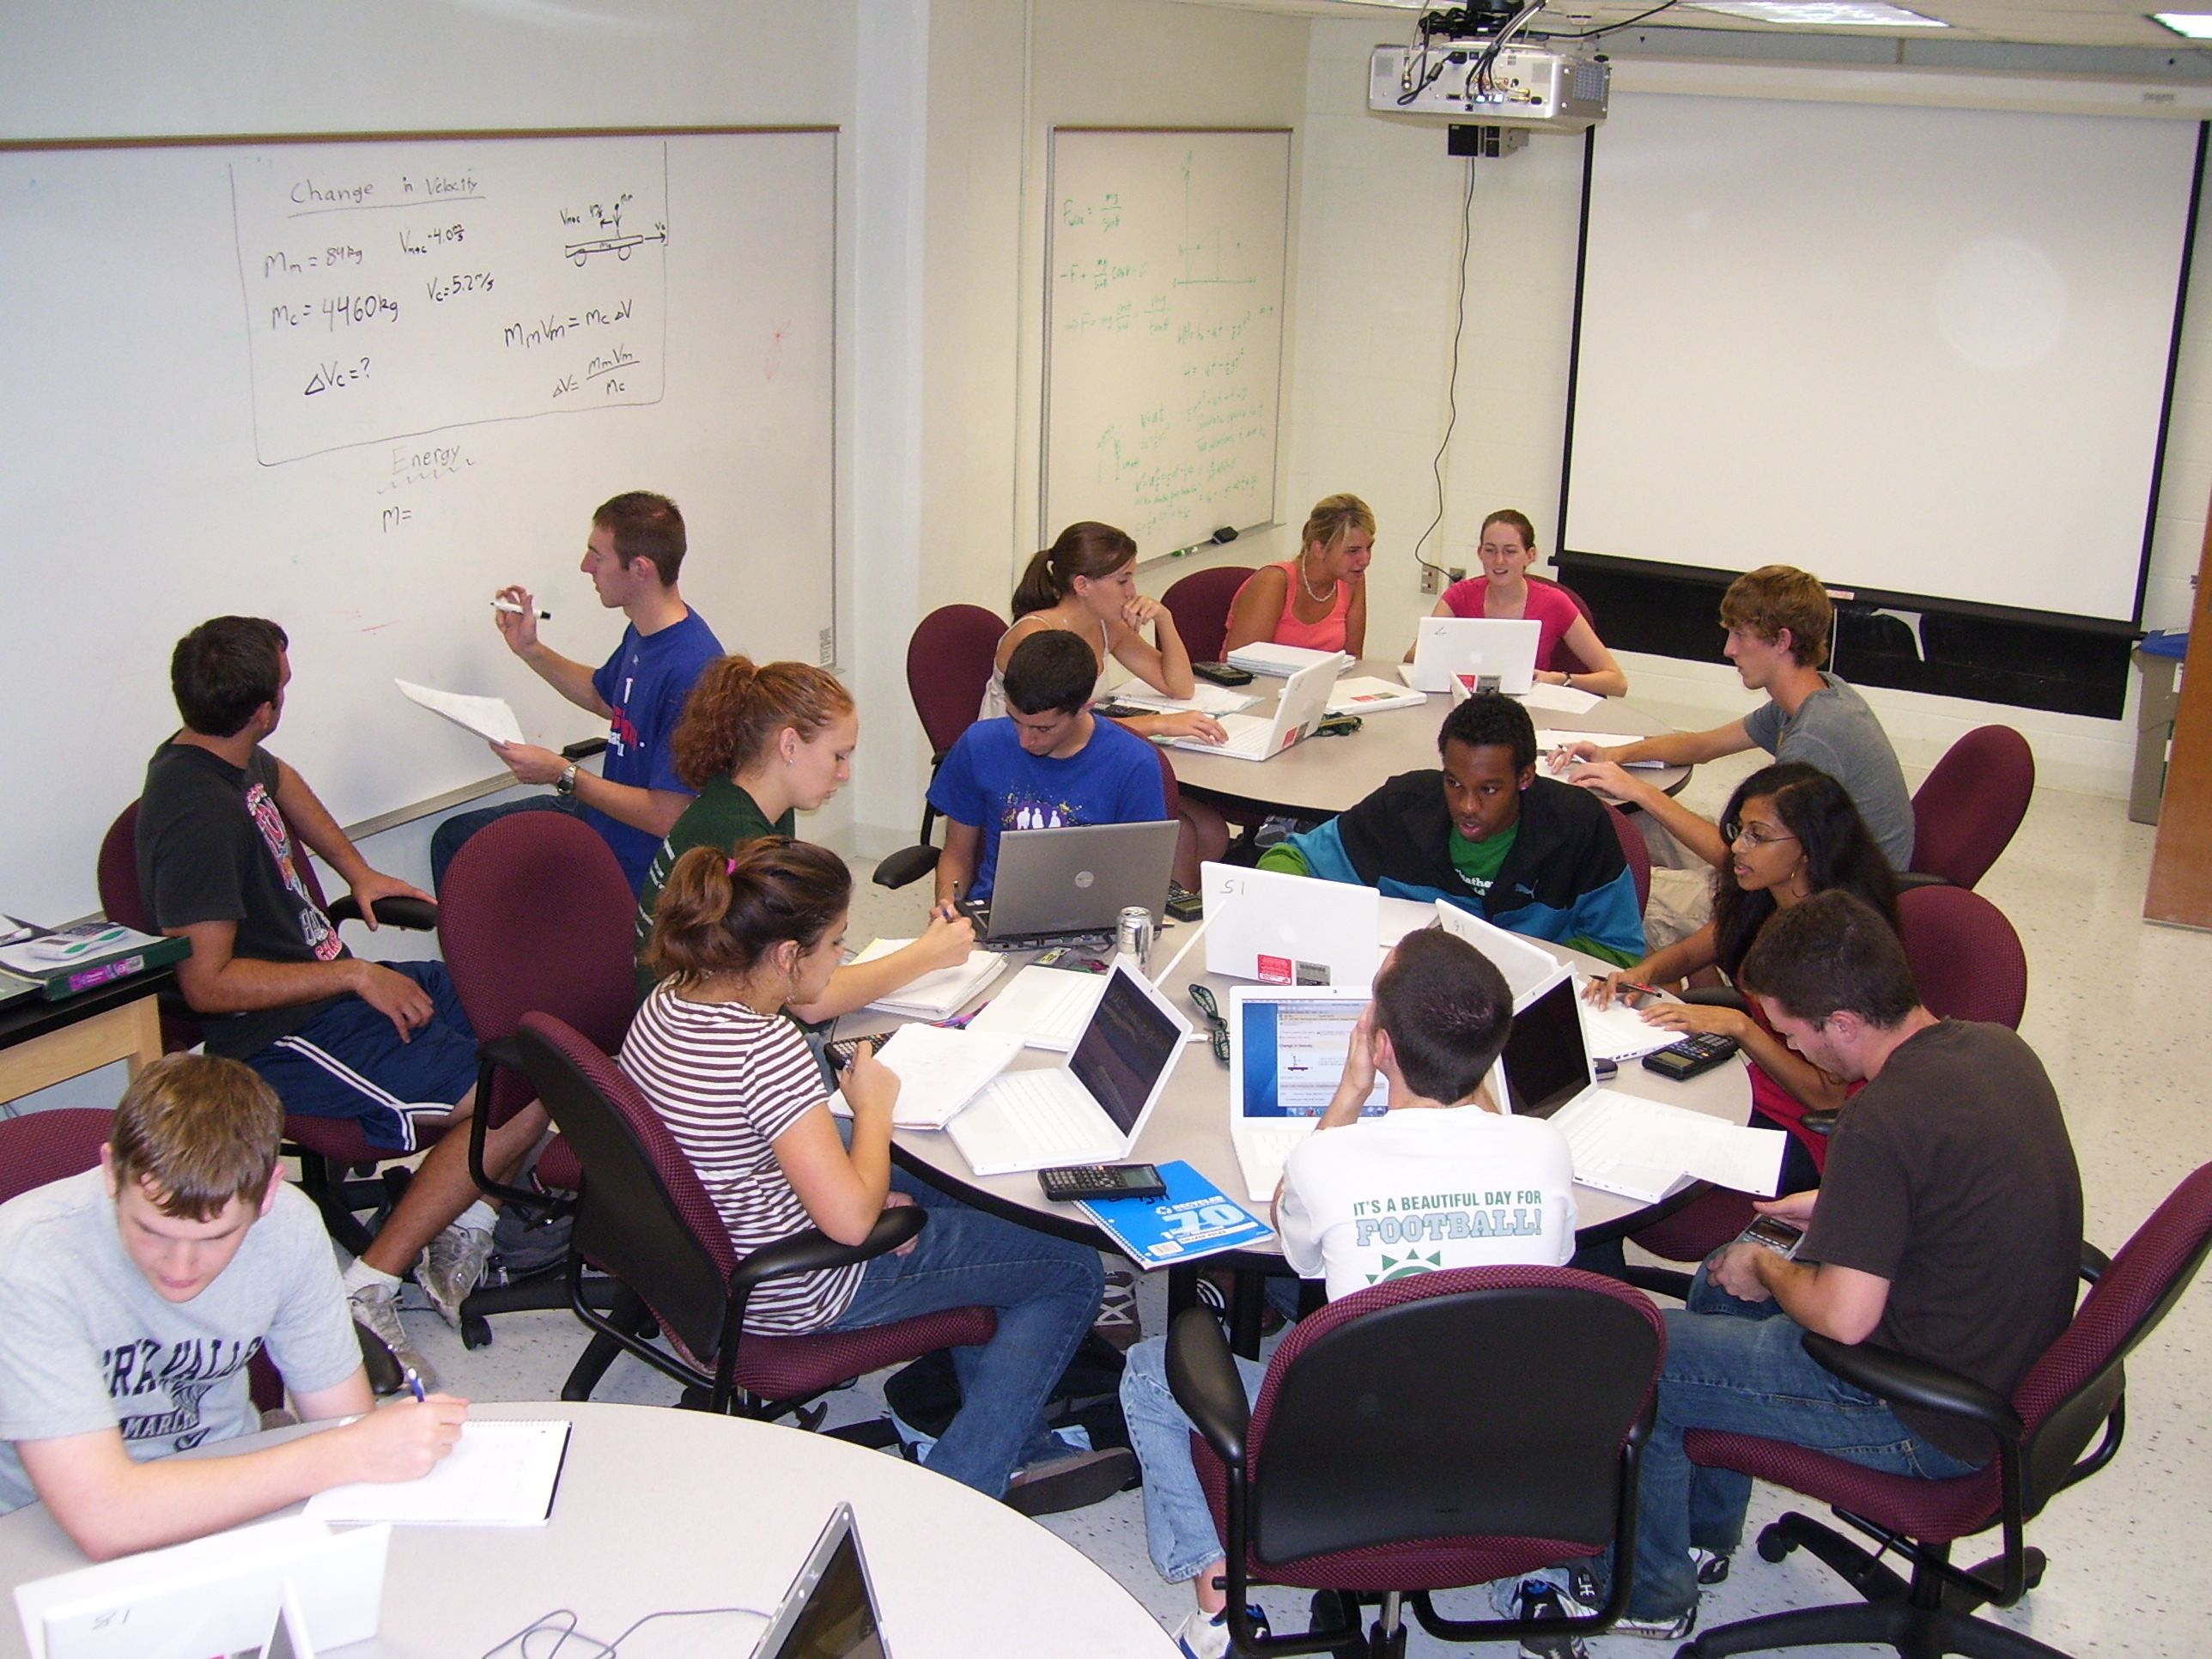
Helprooms
Staffed
with
Learning
Assistants
in the
evenings
Collaborative learning space, peer instruction

Slide 29
Exams
Problems can also be rendered for bubble sheets
Each student has a different exam

Slide 30
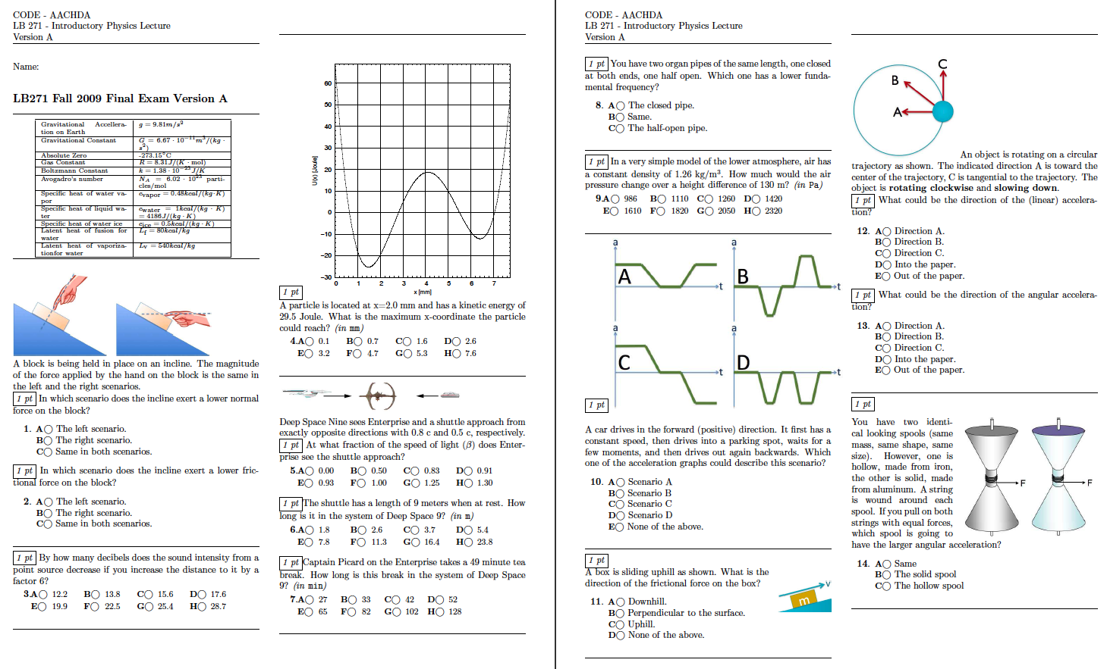
Exams

Slide 31
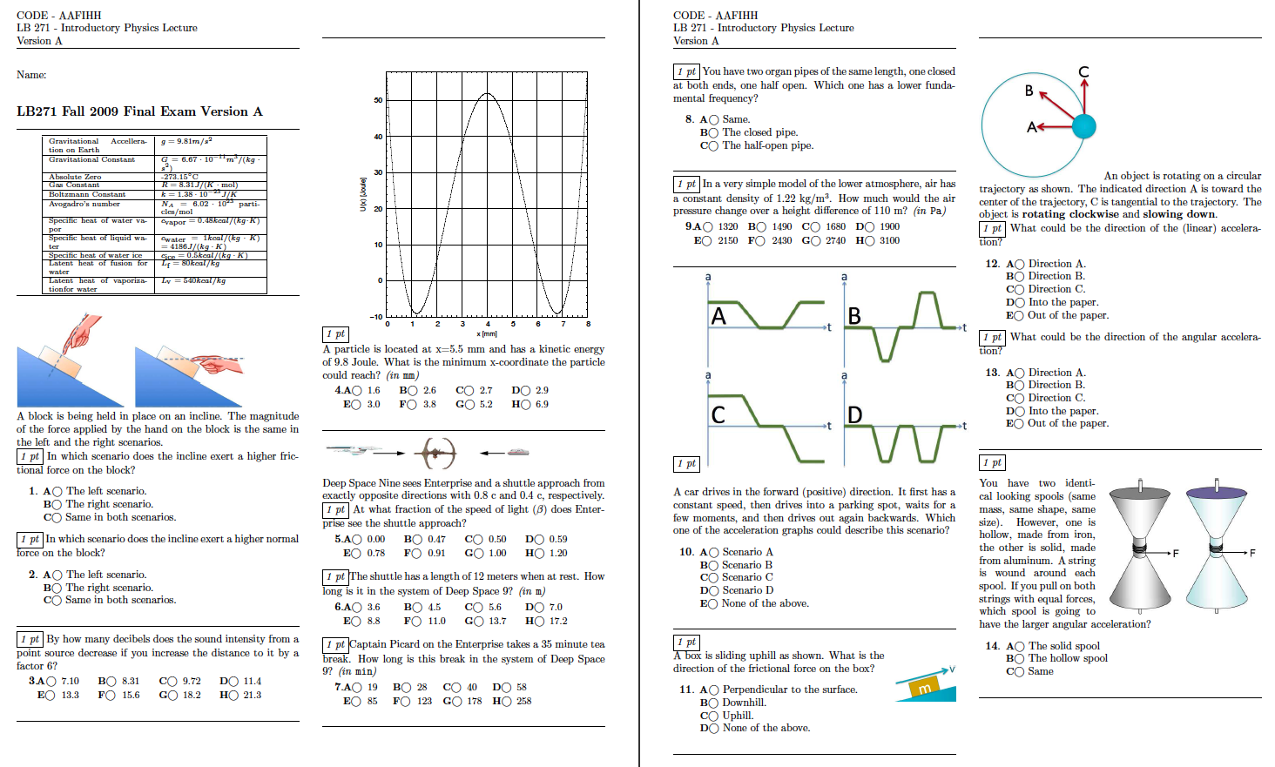
Exams

Slide 32
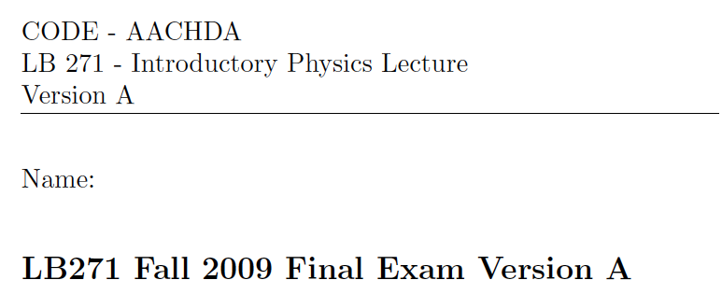
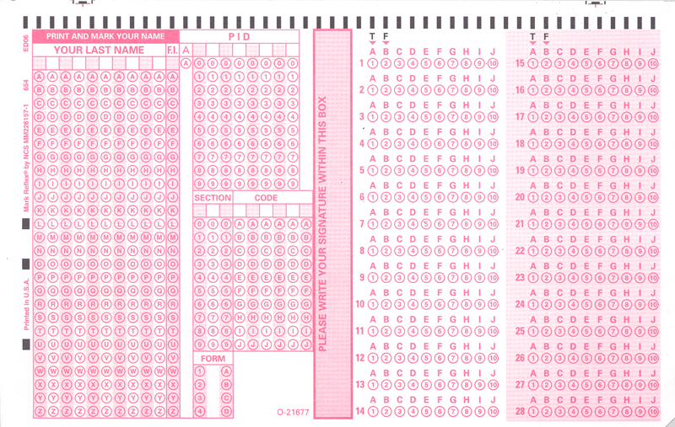
Exams

Slide 33
Before we go on …
… does this even work?

Slide 34
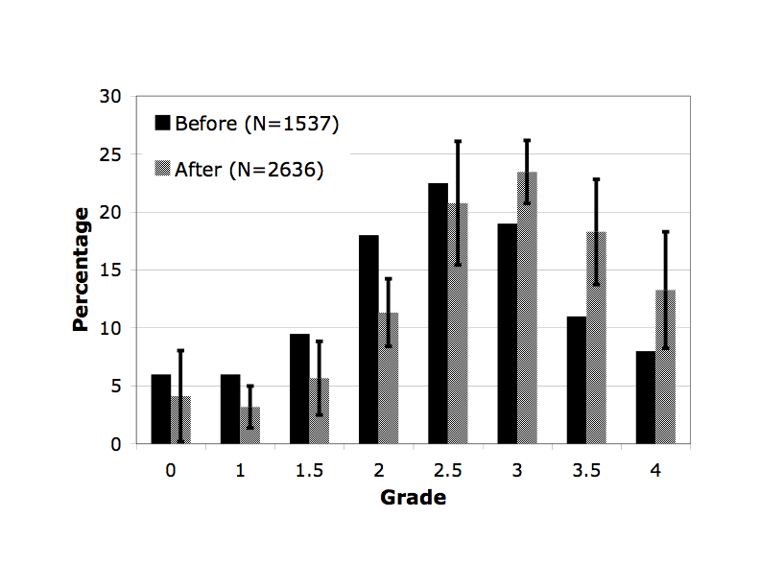
Learning Success
Intro Physics for Scientists and Engineers
Grades in years before and after online homework

Slide 35
Learning Success
Mostly helps students who are on the brink of failing the course.
Fail

Slide 36
How is this realistically possible?

Slide 37
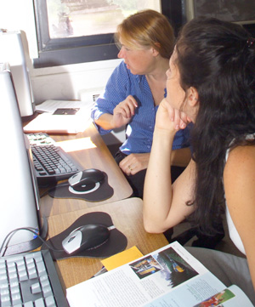
Sharing of Resources
Creating online resources is a lot of work
Doing so for use in just one course is a waste of time and effort
Many resources could be used among a number of courses and across institutions

Slide 38


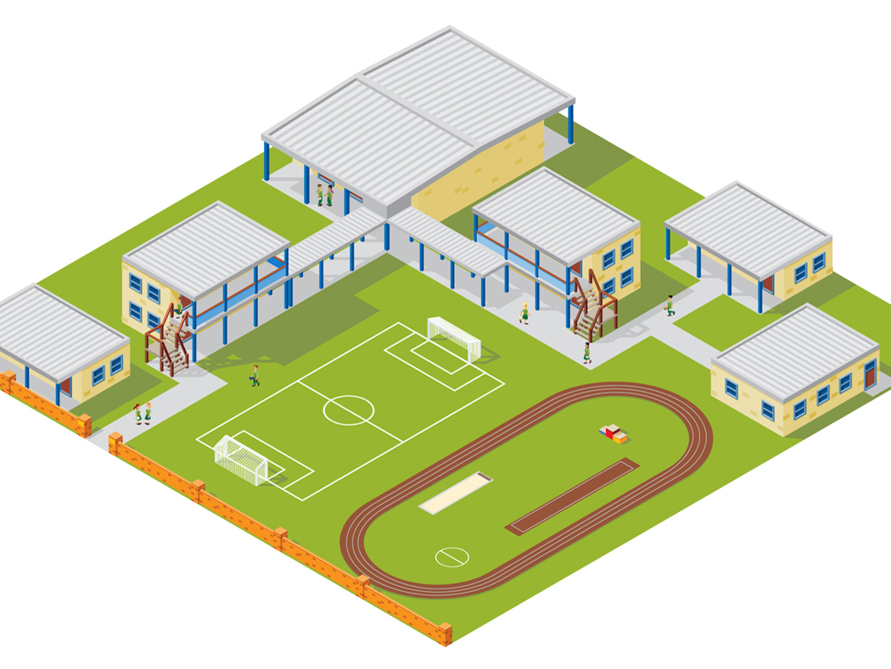



LON-CAPA Architecture
WWW
Web
Instructor
Computer
Interserver
Campus A
Campus B
WWW
Campus C
Inter-Institutional
Network of Servers Connecting Universities and Schools
Student Computer

Slide 39










LON-CAPA Architecture
Campus A
Campus B
Course Management
Course Management
Resource Assembly
Resource Assembly
Shared Cross-Institutional Resource Library

Slide 40
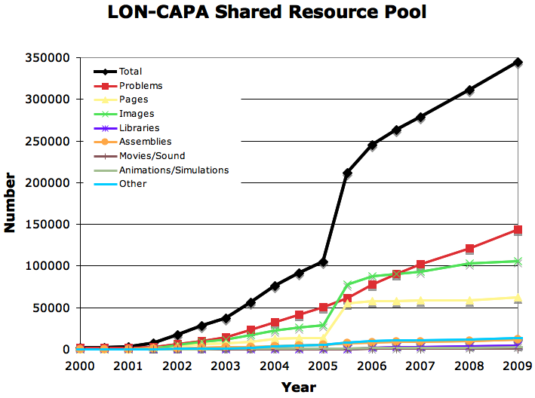
The LON-CAPA Community
Shared content repository with almost 350,000 resources
Almost 150,000 online homework problems

Slide 41




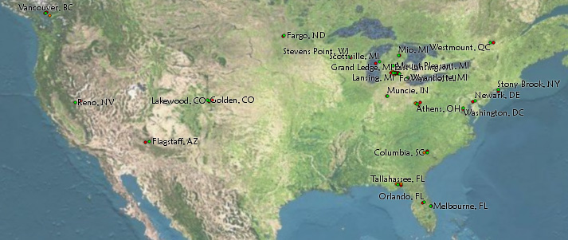



Resource Assembly
Writes module about
energy conservation
Compiles module about conservation laws
Writes module about
momentum
conservation
Uses whole
assembly
in his course

Slide 42

The LON-CAPA Community
High Schools, Colleges, and Universities
Great Britain: 1
Germany: 3
Canada: 7
Turkey: 1
South Korea: 1
USA: 108
Switzerland: 1
Israel: 2
Taiwan: 1
Nigeria: 1
Brazil: 2
South Africa: 1
… plus grant projects and publishing companies.

Slide 43
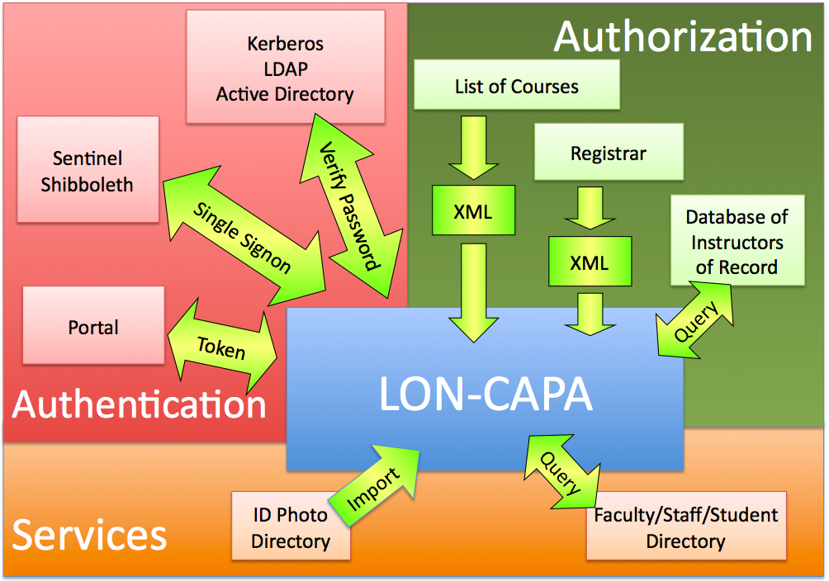
Think Global, Act Local

Slide 44
Thank you!
Gerd Kortemeyer
korte@lite.msu.edu
http://www.lon-capa.org/

